Slide 1
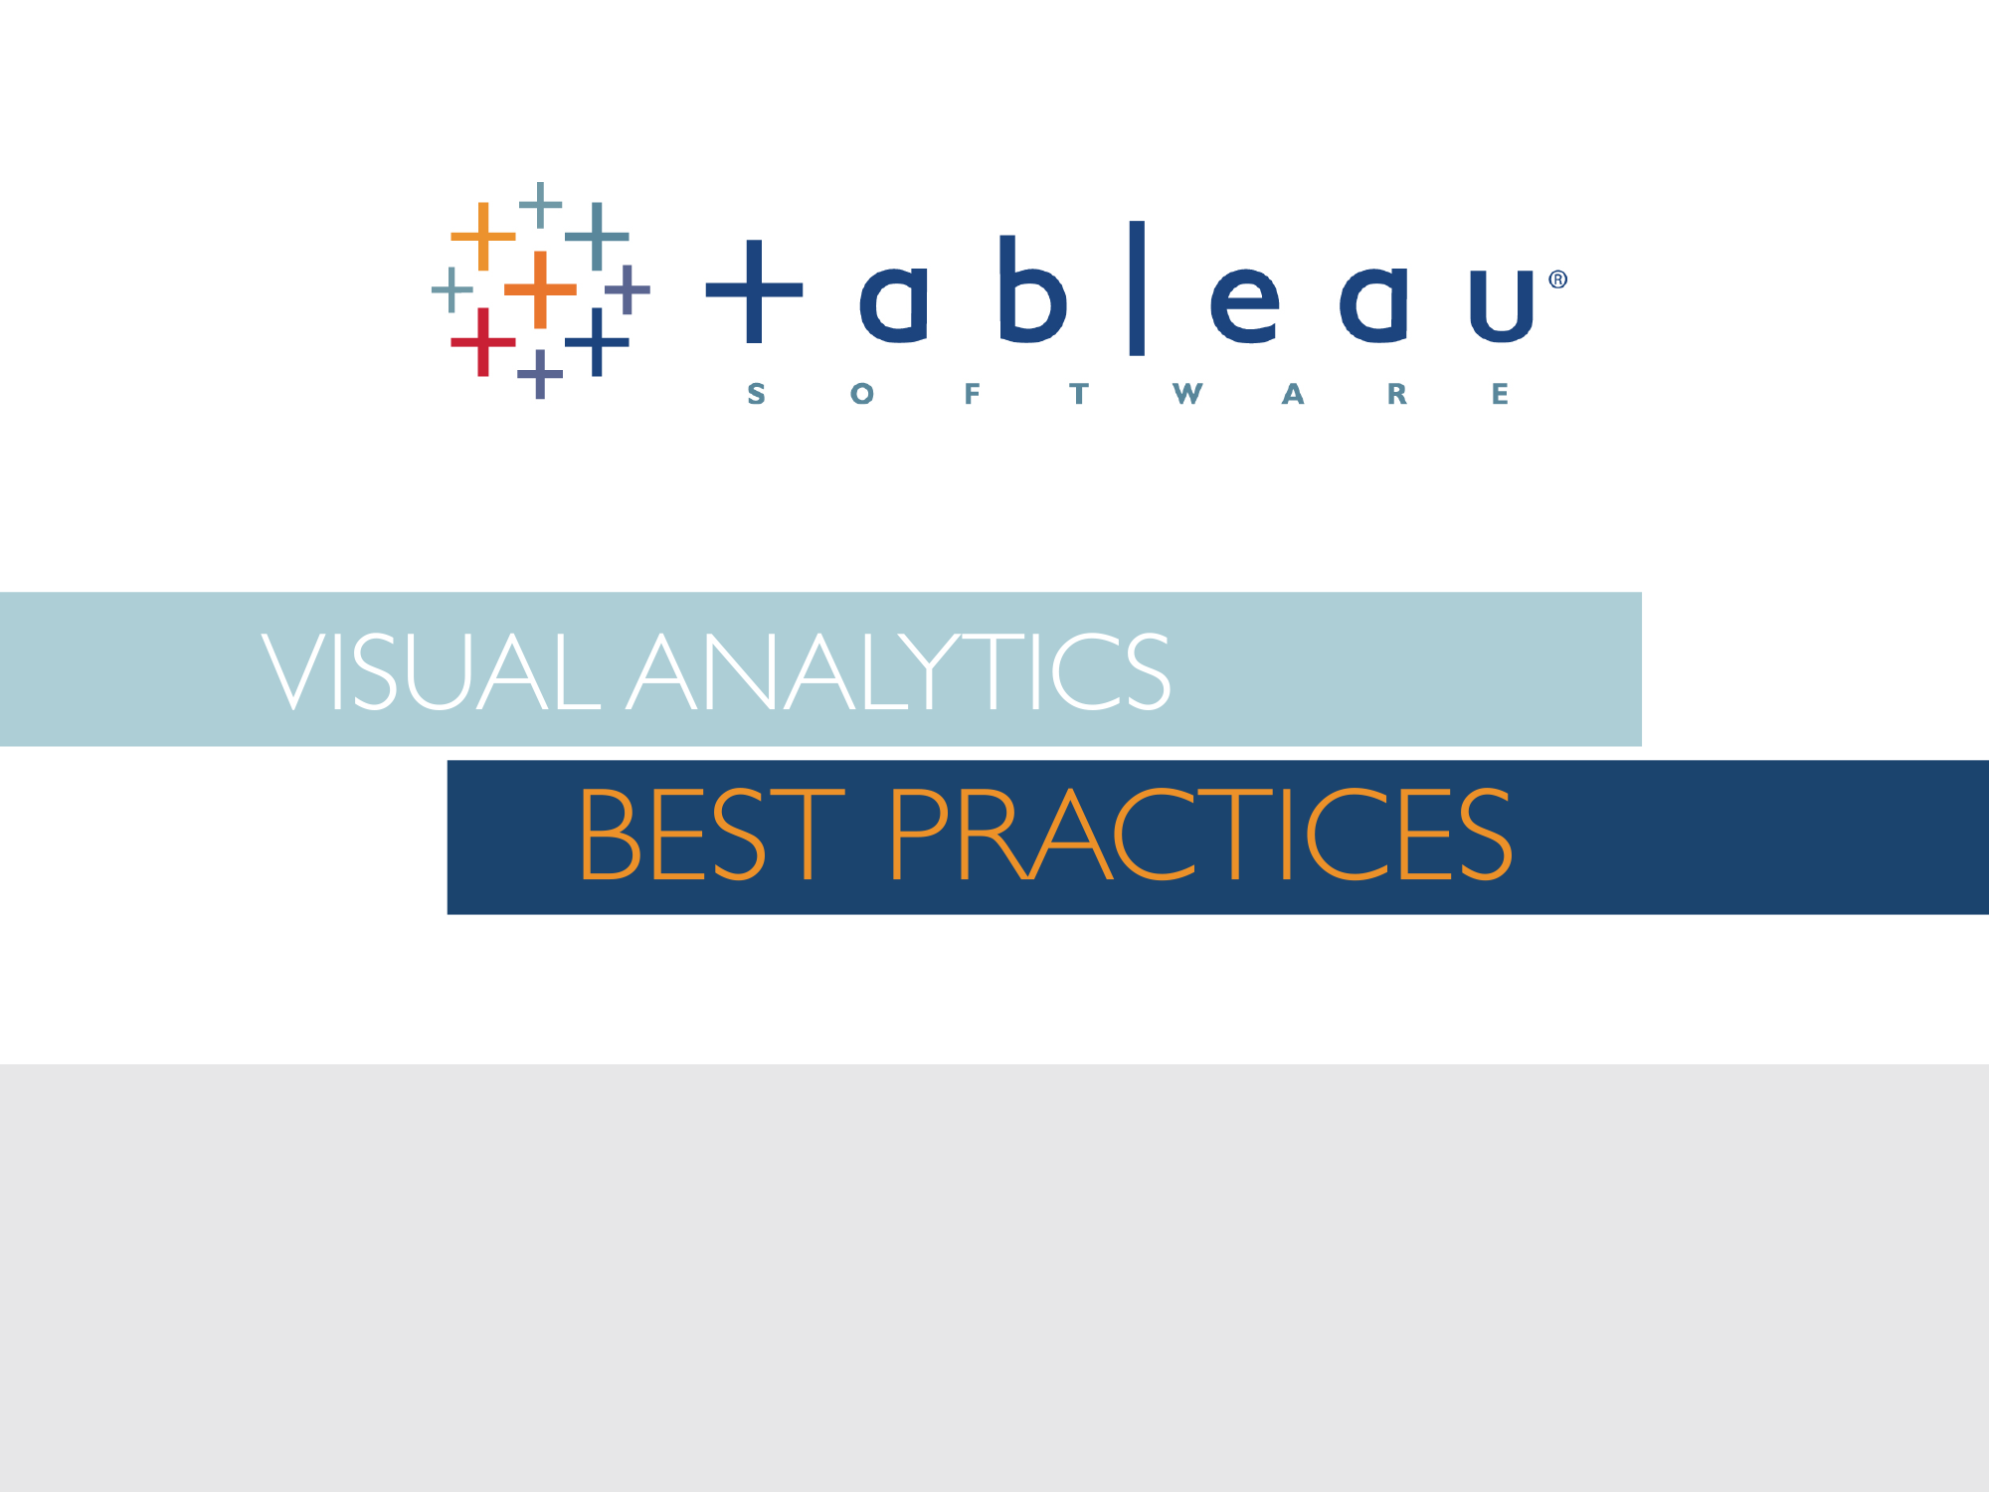
Sasha Pasulka
Senior Manager, Product Marketing
Slightly adapted by Marc van Kreveld for Pattern Recognition

Slide 2
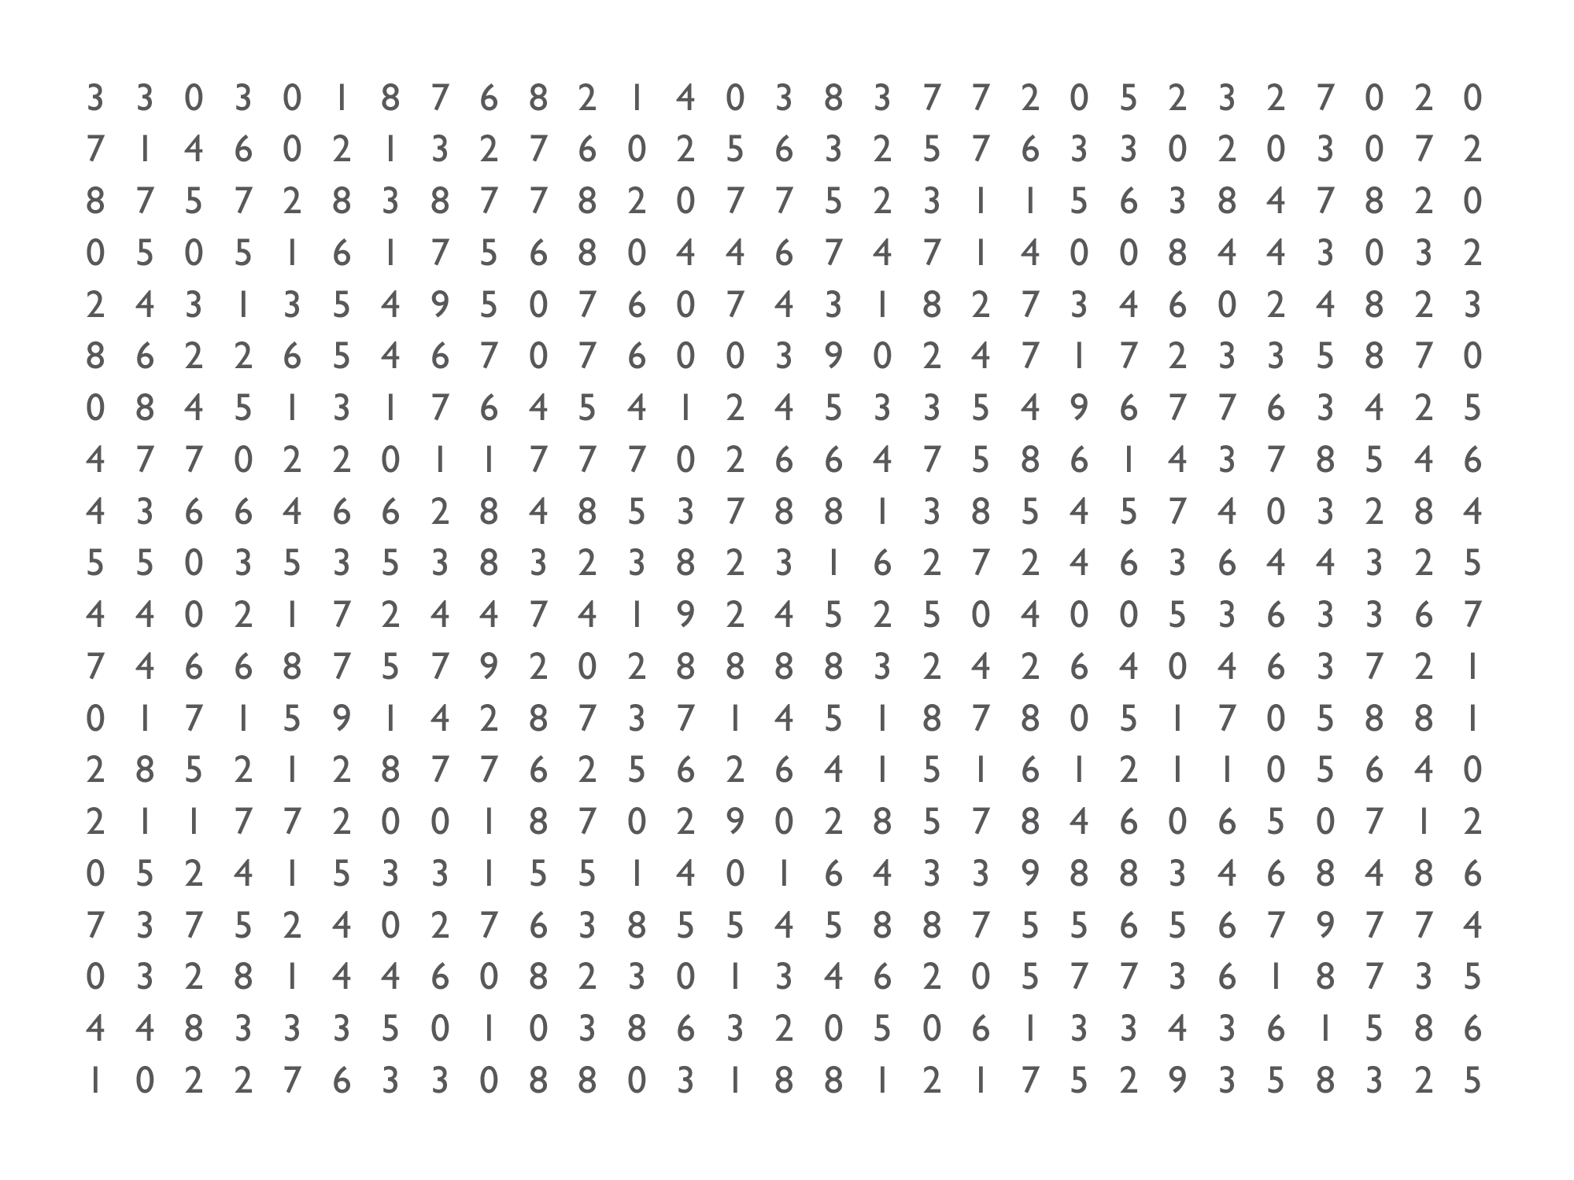
Notes:
I like to start these sessions off with a game I call “count the nines.” So, count the nines. Raise your hand when you think you know how many nines there are on here. [pause] In fact, just go ahead and shout it out. If you know how many nines are on here, shout out the answer. [pause]

Slide 3
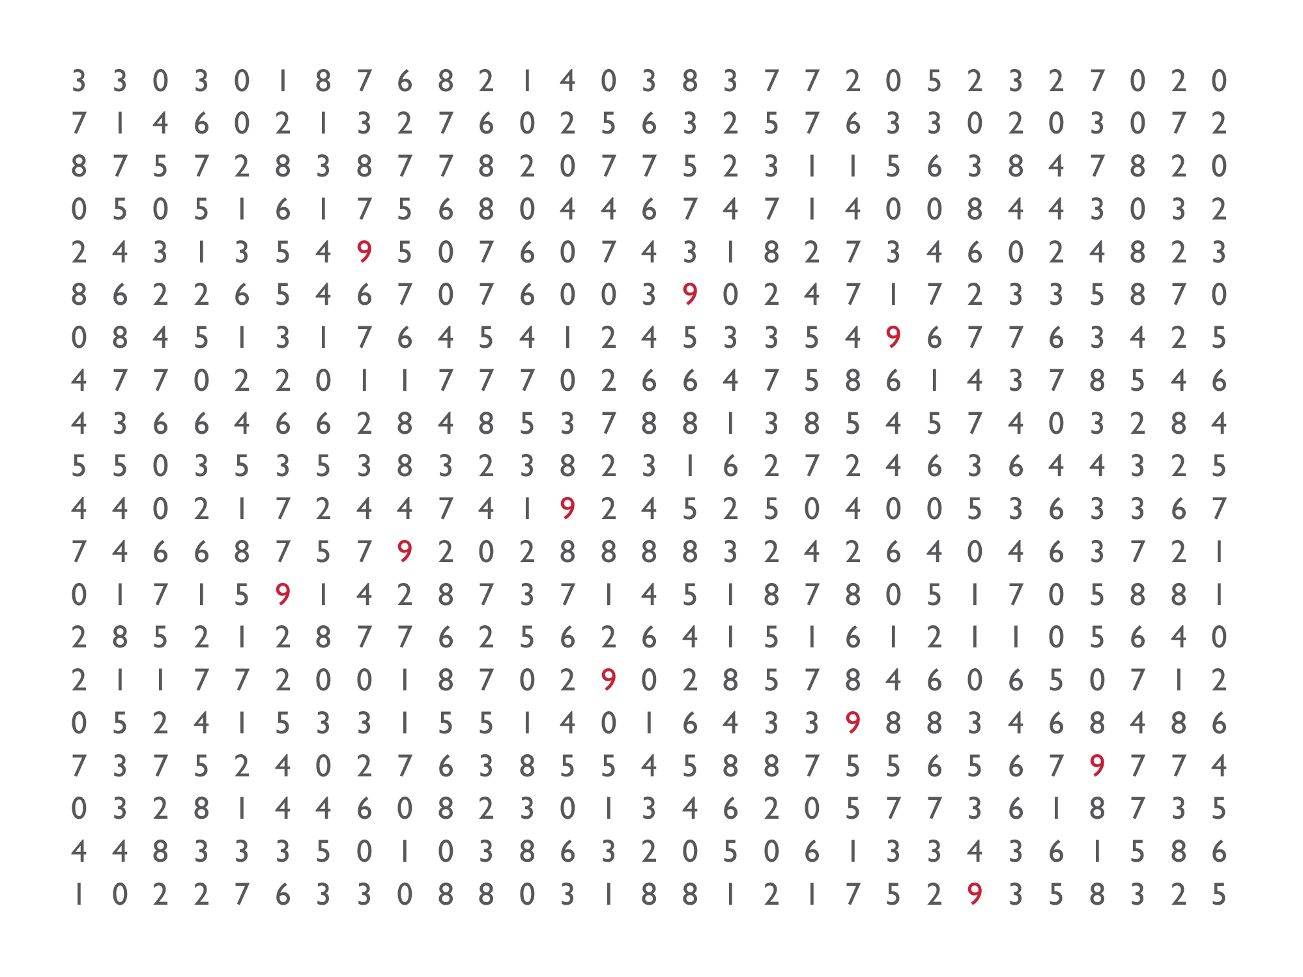
Notes:
NOW count the nines. How many nines do you see? Raise your hand when you know.

Slide 4


The power of human pattern recognition

Slide 5
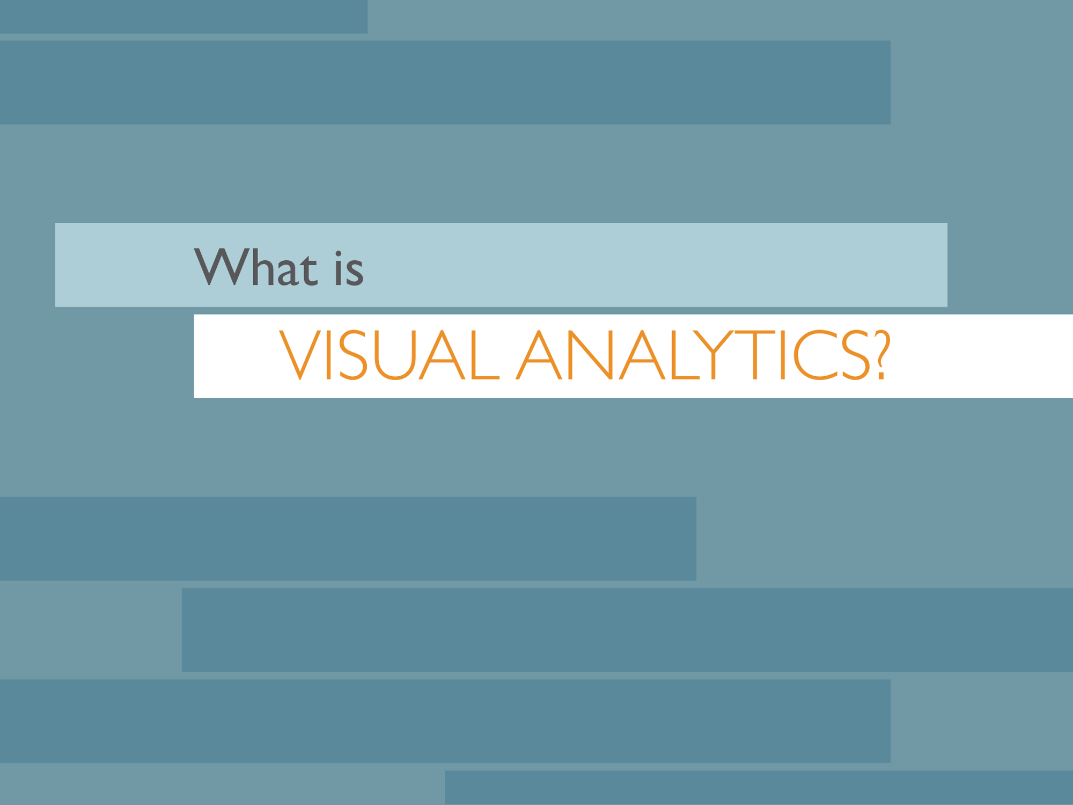
Notes:
So what is visual analytics? THAT’s visual analytics.

Slide 6
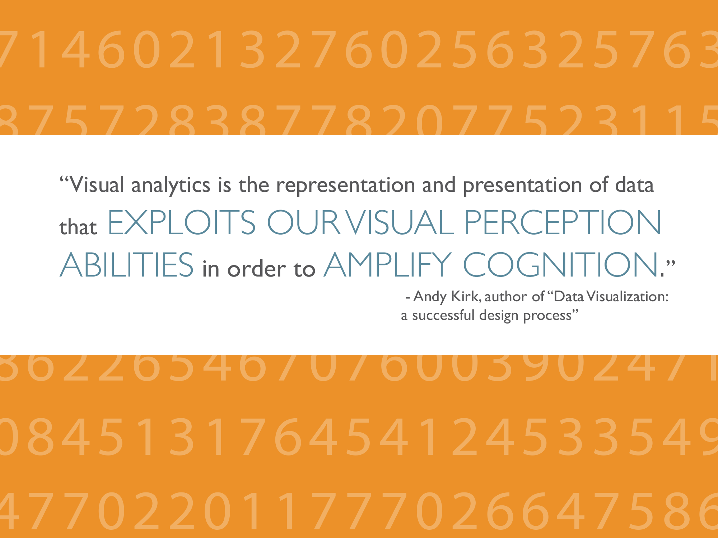
Notes:
Those are really fancy words for what you just experienced. Humans can see visual patterns very well, but only when the patterns really play to a human’s strengths.

Slide 7
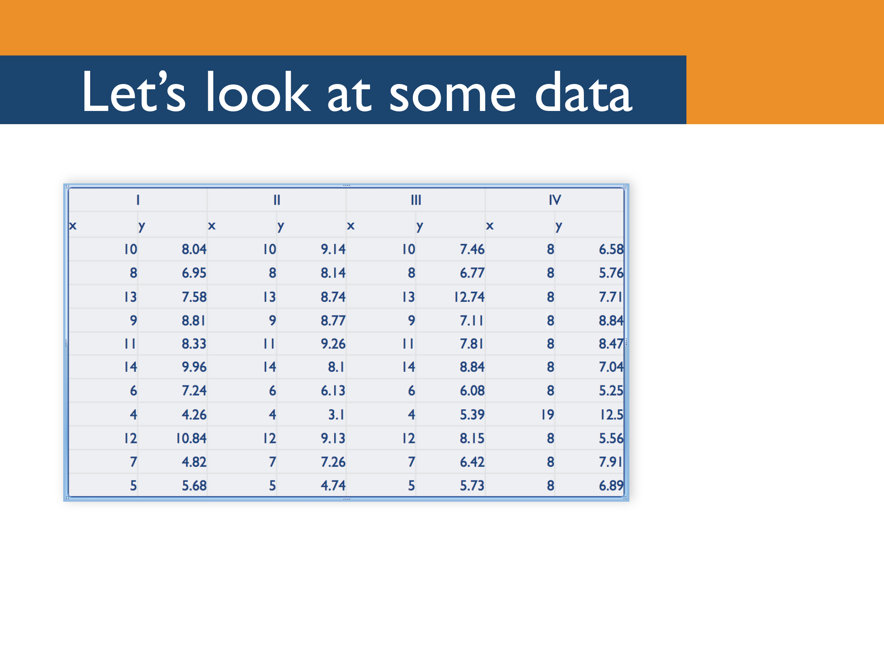
Notes:
Let’s see another example. Here’s some data. The are 4 sets of data here, each with 11 sets of x-y coordinates.
For the purposes of this exercise, let’s assume the x data represents, in millions, the net sales of a single retail store over the course of a month. Let’s say the y data represents, in millions, the total profit from that store. So we’re looking here at a set of points that represent profit by sales, where each point is a single store. The four data sets represent regions, say, West, Central, South and East.
Let’s say you’re a manager responsible for maximizing profit at these stores.
What’s your move? [pause for 10 seconds, let people try to say smart things ☺]

Slide 8
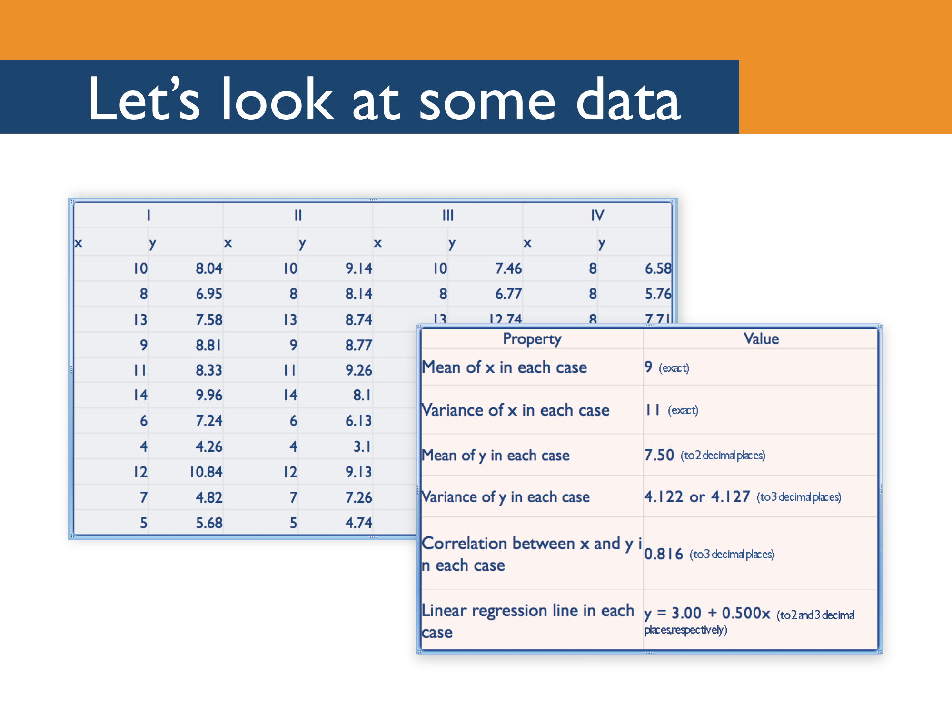
Notes:
OK, OK, so you’d typically have a bit more information than that when you’re making a decision. So now let’s look at some more information about these data sets. Maybe we can learn something about them from their means, or their variances. When we’re crunching numbers, we rely a lot on things like means and variances. And probably looking at correlation or doing a linear regression would help, too. It turns out that these four data sets all have the same means, the same variances, the same x-y correlations, and even boil down to an identical linear regression.
So … what’s your move? [Pause for 10 seconds or so]

Slide 9
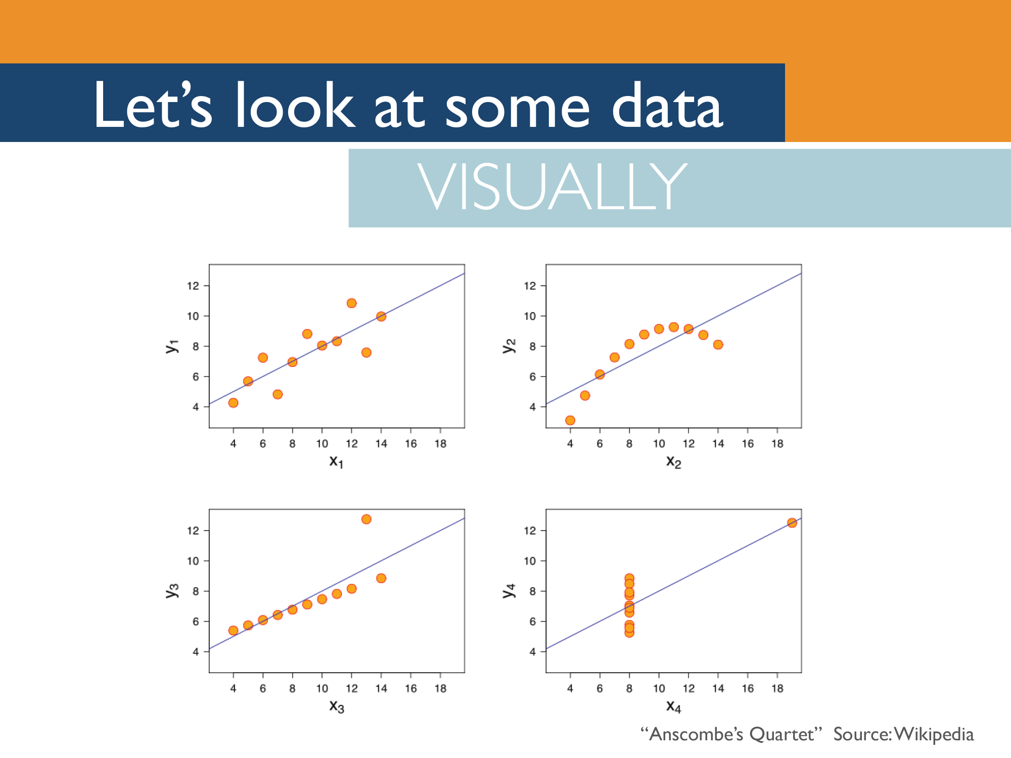
Notes:
Here are these same four data sets, plotted visually, with trend lines.
Now, what’s your move? [Let the audience make some suggestions. You can chime in with things like, “Yeah, you might want to talk to the manager of the outlier in set 3 and see what she’s doing right” or “You might want to talk to the managers of some of the stores in set 4 and see why their profits are underperforming compared to stores with similar sales.”]
What other pieces of information might you want? [Let them make suggestions, and if necessary you can chime in with things like “You might want to see how many orders each store is producing, or what categories of product they’re selling most, or how frequently they offer discounts.”]
It would be nice to be able to encode some of that information on these graphs, like maybe have a larger circle for stores that offer, on average, larger discounts, or to be able to quickly split this data up to show sales by product category by store. Like, maybe with just one click. And then it would be nice to be able to share this view with your individual store managers, with just a couple of clicks. And it would be nice to have that view you shared update with real-time data, so those store managers could see day-by-day how their stores were performing compared to their peers, and interact with that live data to understand why their stores are succeeding or lagging. So that they are each empowered to explore the information they need to meet and exceed their profit goals.
That’s what Tableau does.

Slide 10
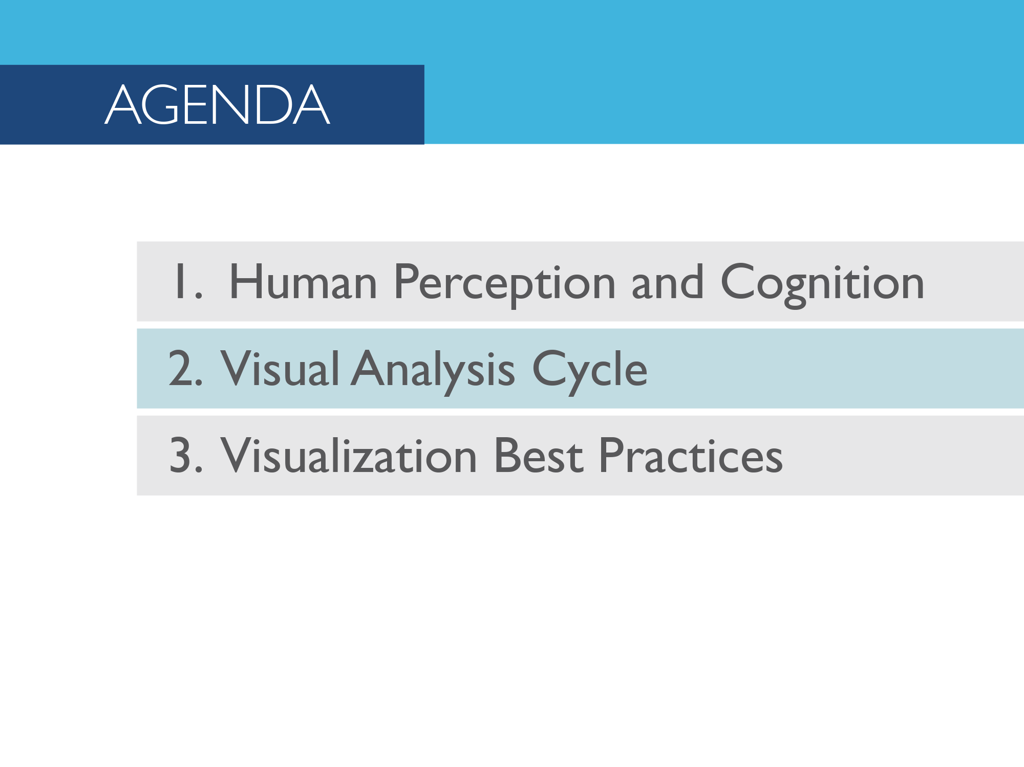

Slide 11
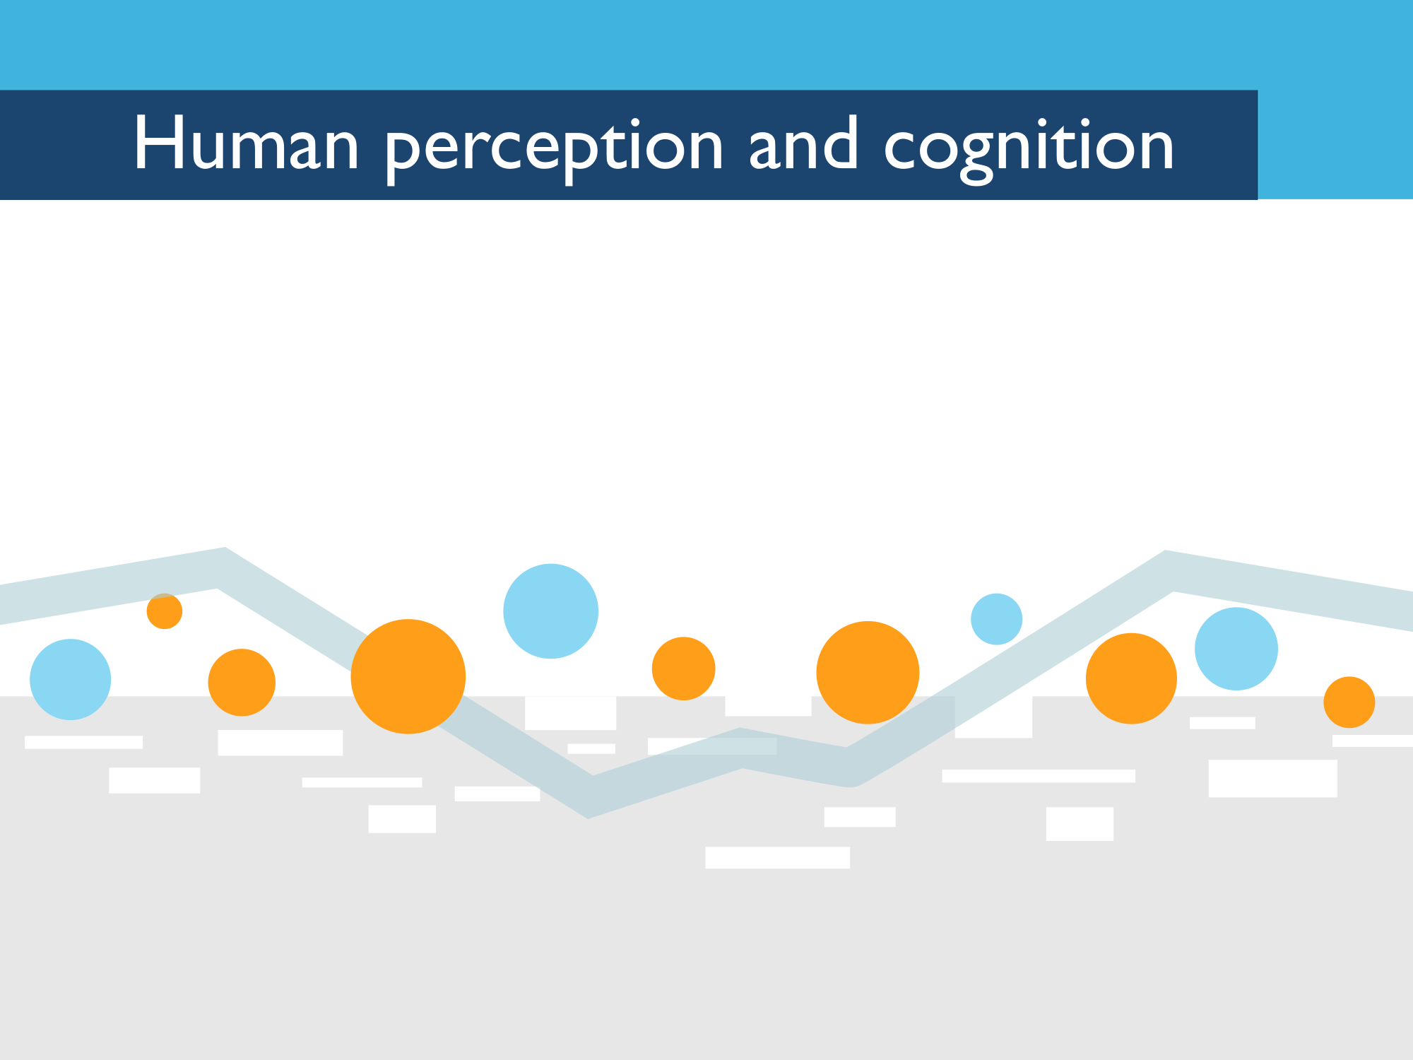

Slide 12
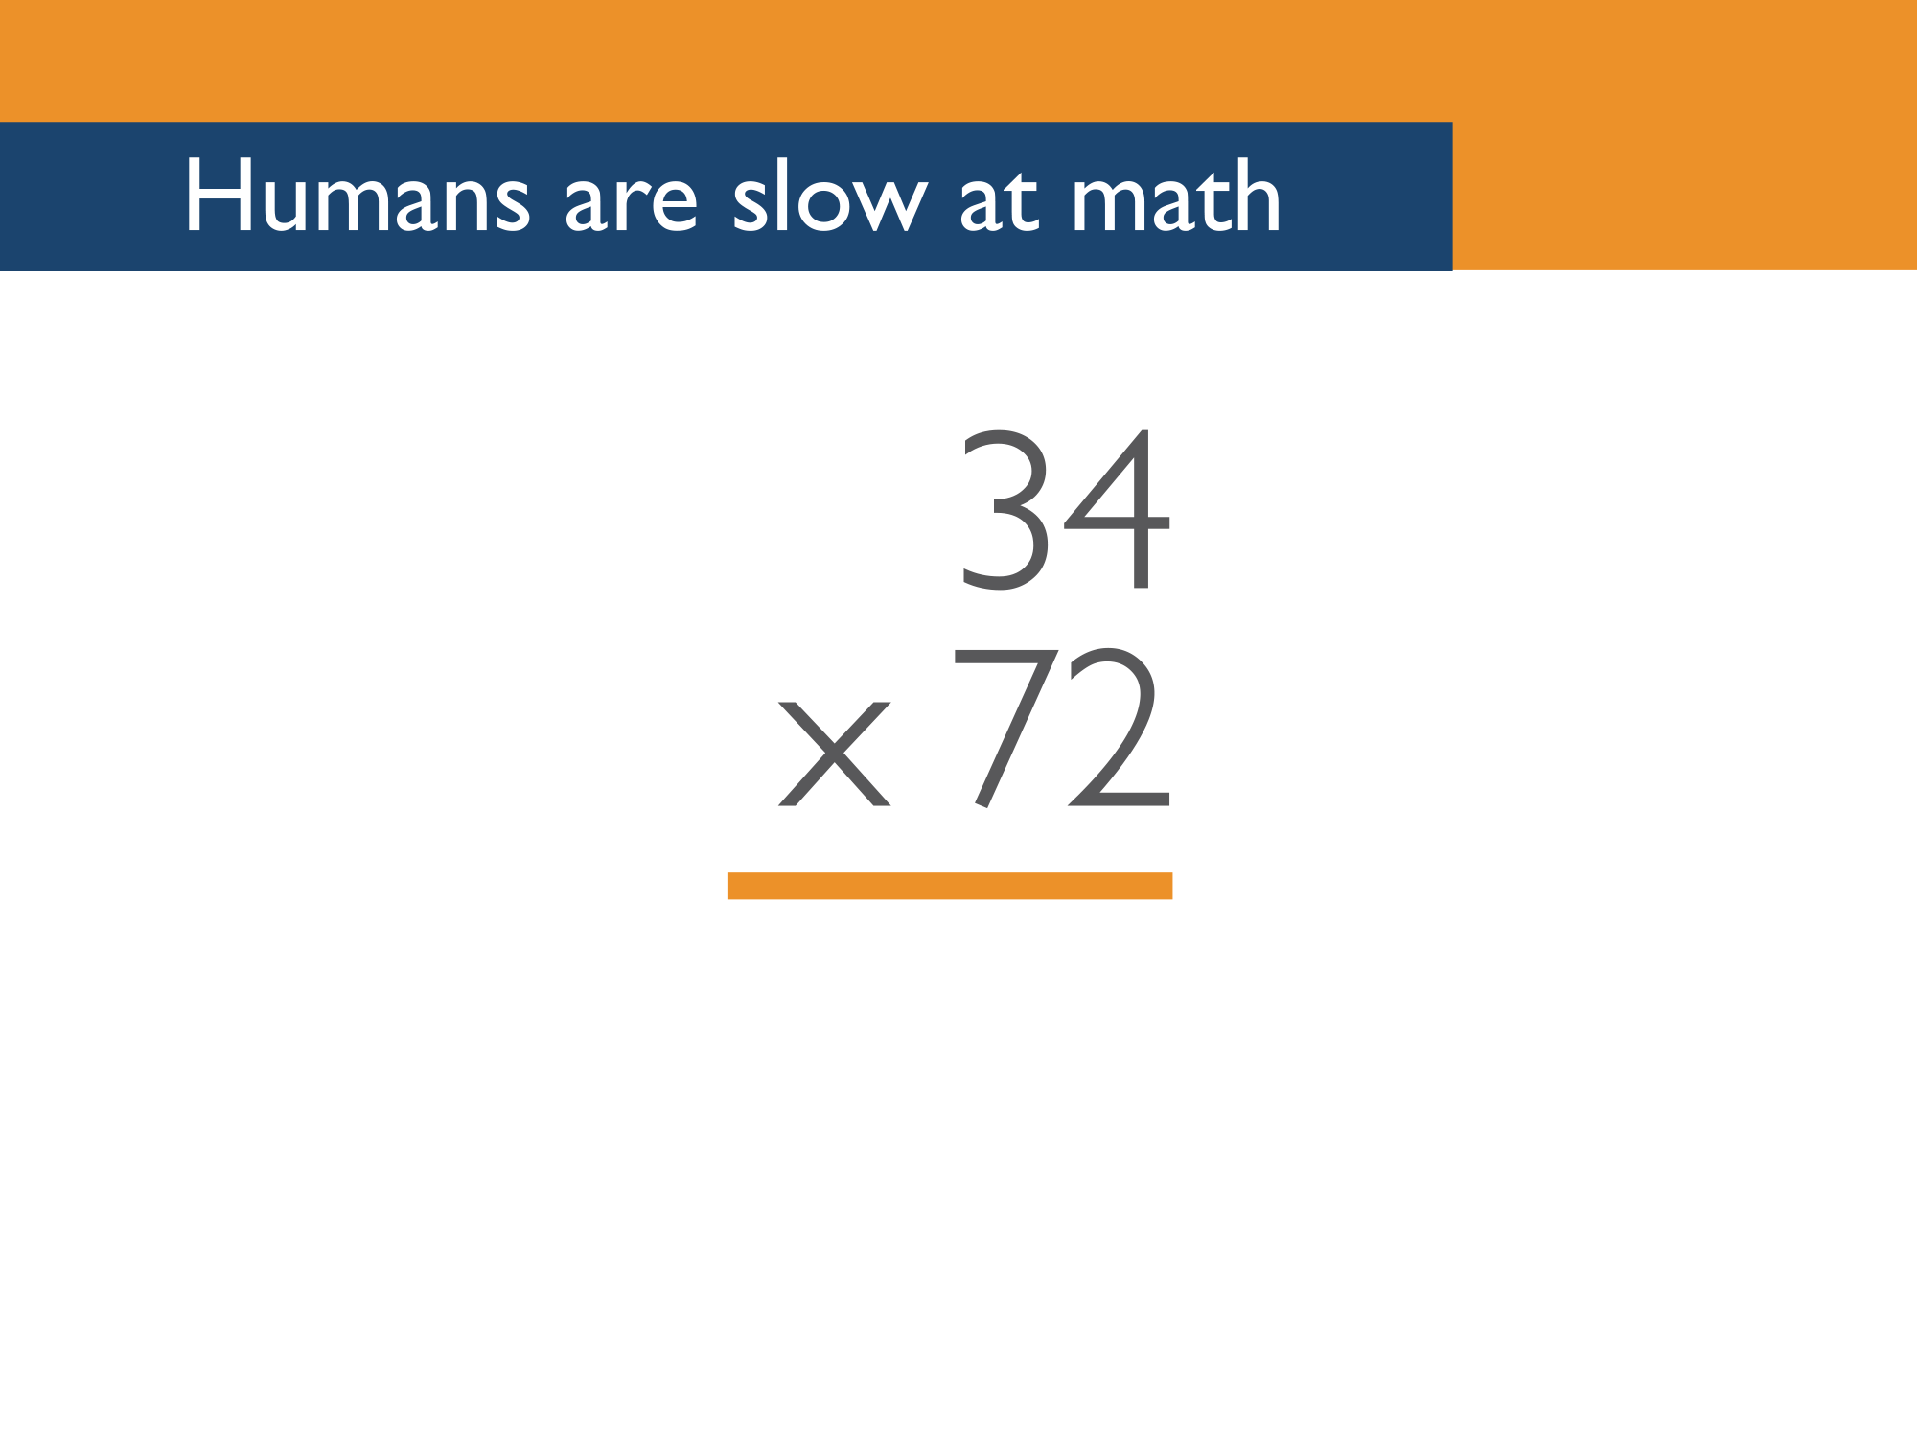
Notes:
Humans are slow at mental math. We’re not designed to manipulate complex numbers in our heads. Go ahead and try to solve this multiplication problem in your head. Don’t use any tools – no iPhone, no computers, no pencil and paper. Shout out the answer if you know it. [pause while people shout out answers – they’ll almost always be wrong]
OK, now use a tool. Any tool. Shout out the answer when you have it. [pause]

Slide 13
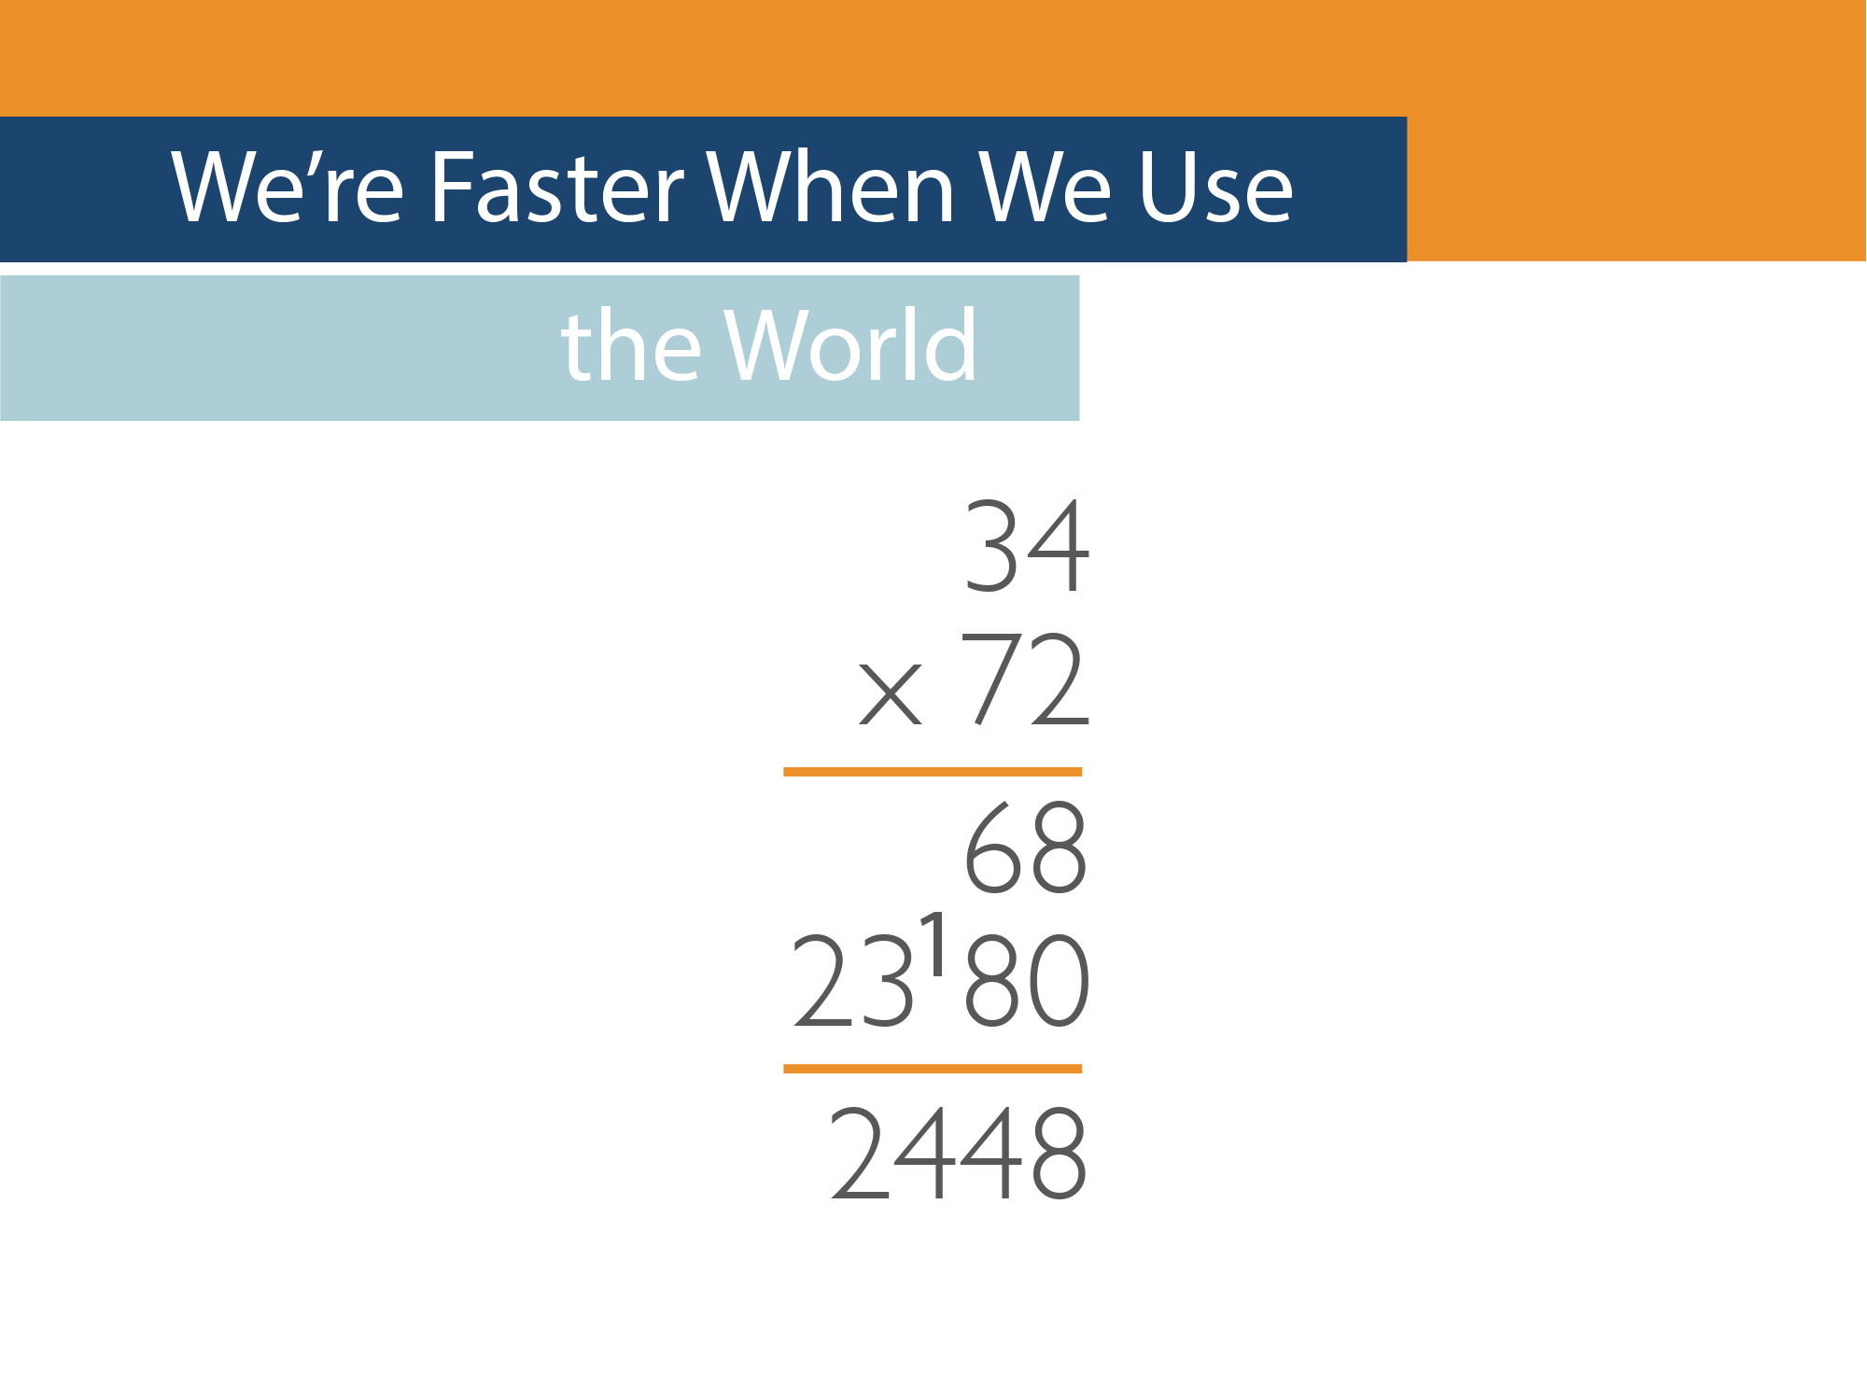
Notes:
If we give you a tool to use, all of a sudden this problem becomes a lot easier to solve. How much easier?

Slide 14
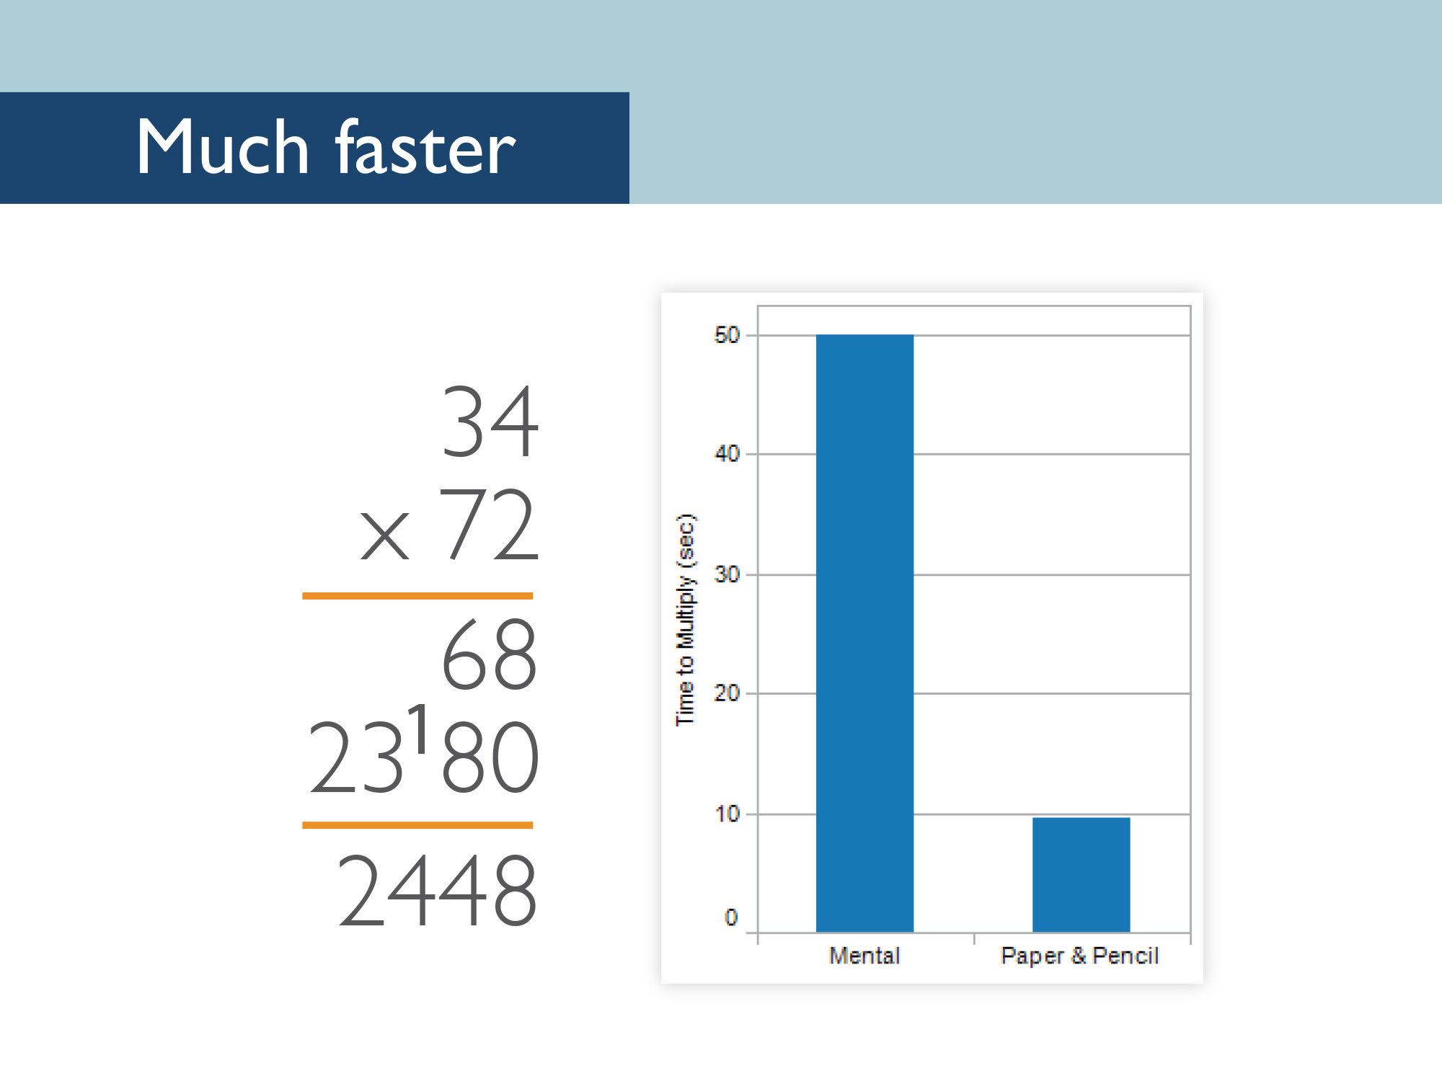
Notes:
About 5 times easier. It takes educated people an average of 50 seconds to solve this problem in their head. Give them the right tools, and suddenly it’s solved in just under 10 seconds.

Slide 15
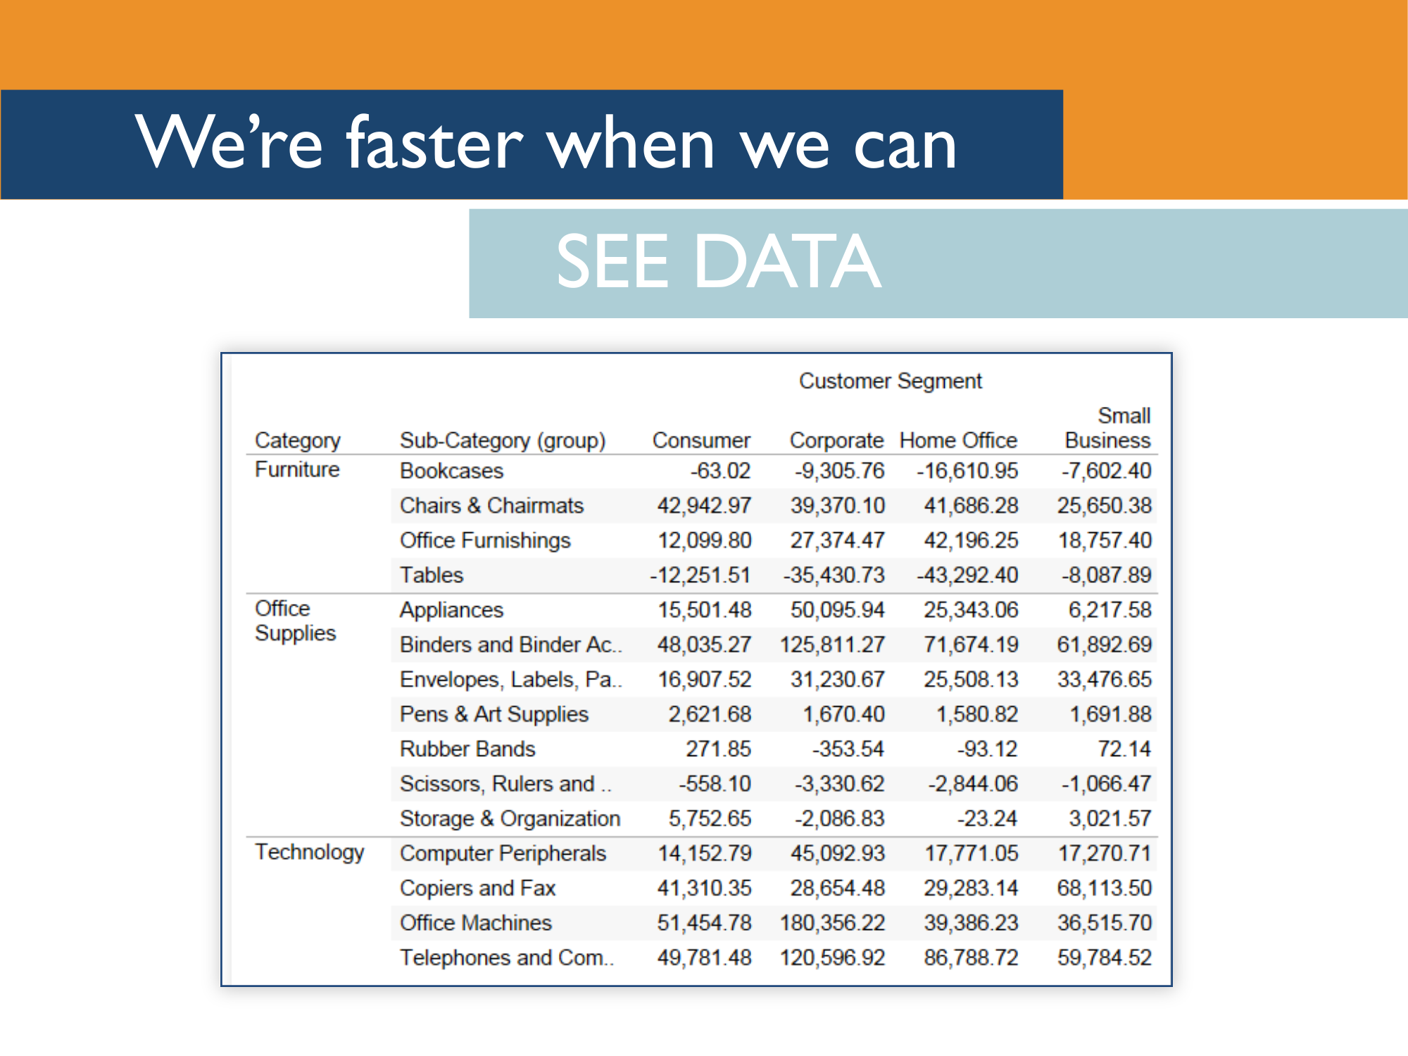
Notes:
Humans are faster when they can see data. Take a look at this data. Which customer segment is doing the best? [pause]

Slide 16
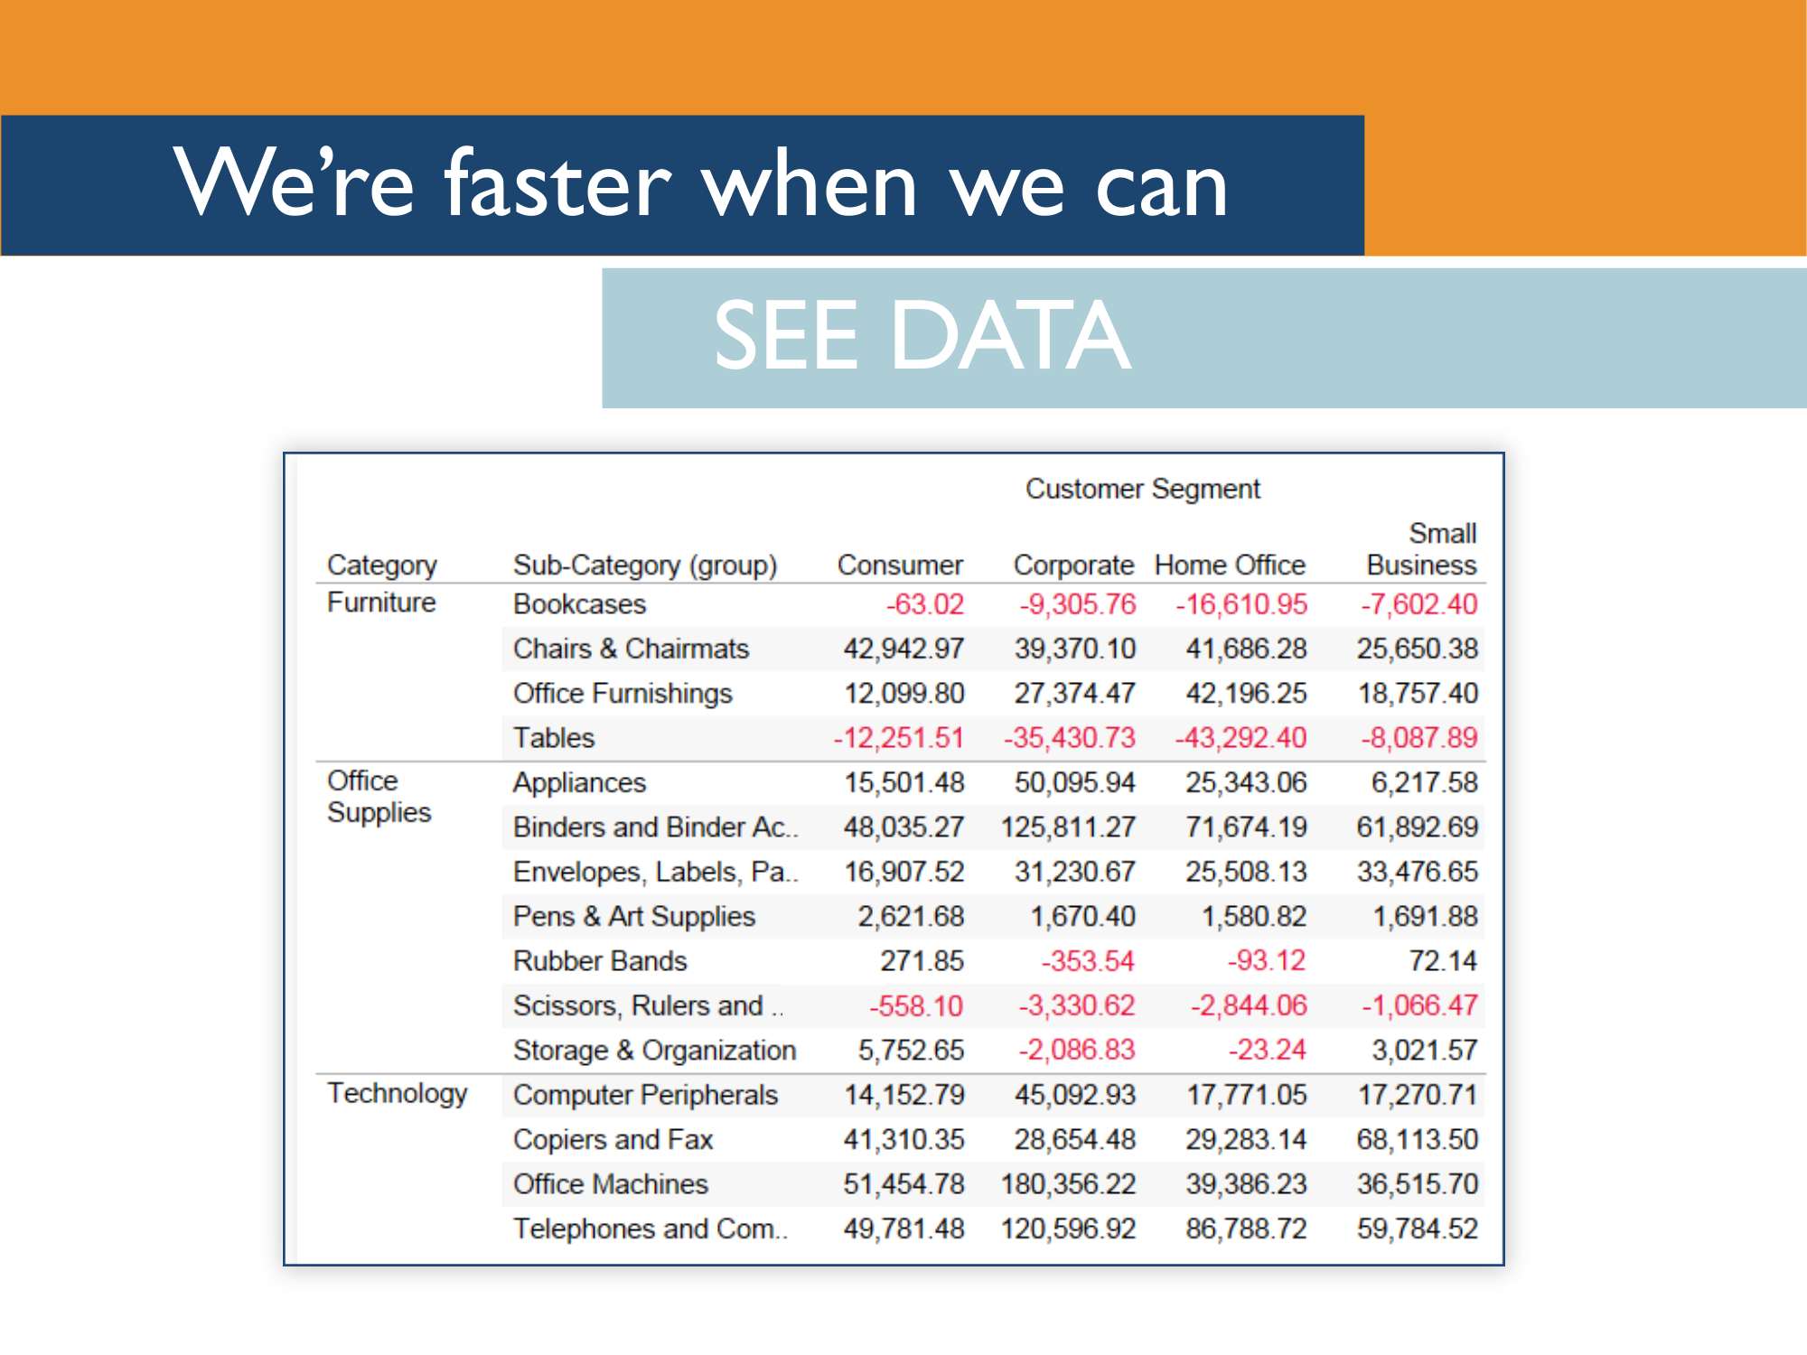
Notes:
OK, OK, let’s add a little bit of visual data. Now which customer segment do you think is performing best?

Slide 17
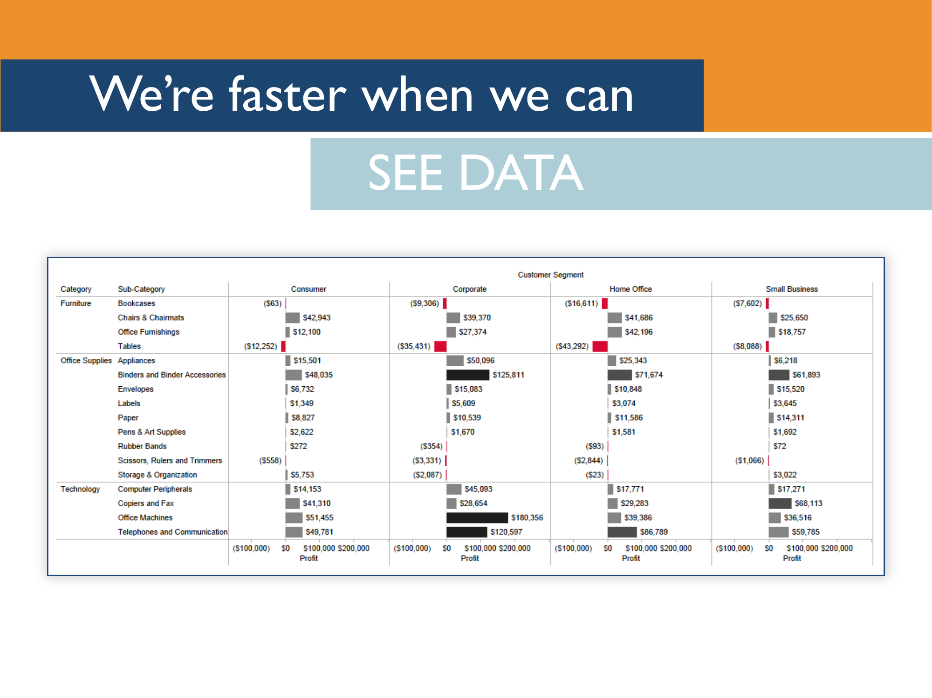
Notes:
Now let’s make it even more visual. We’ll turn it into a set of bar charts. Now can you tell which customer segment is performing the best?

Slide 18
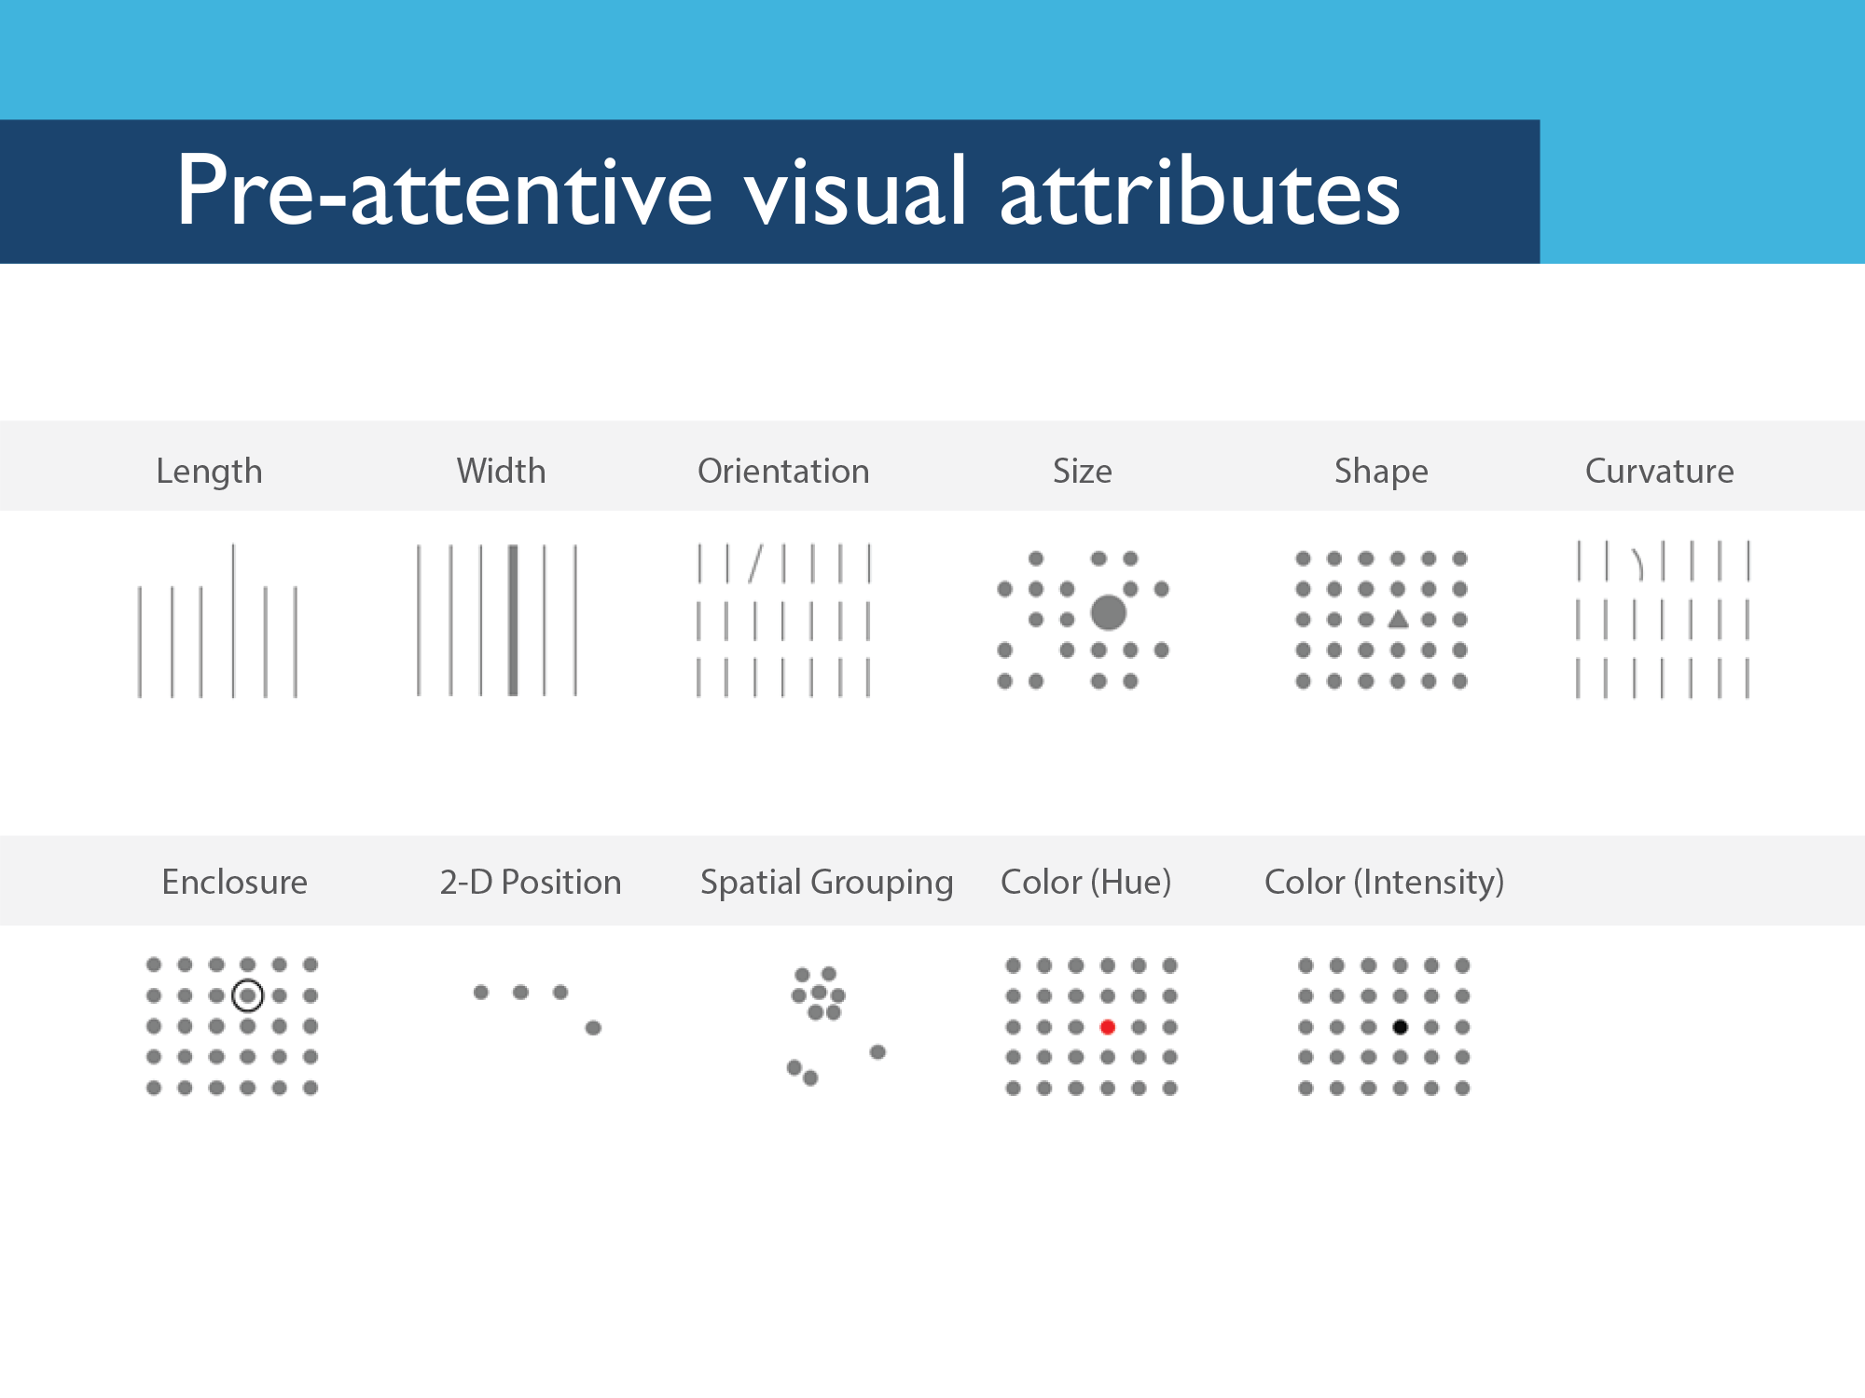
Notes:
Preattentive attributes are information we can process visually almost immediately, before sending the information to the attention processing parts of our brain. This is information we process and understand almost unconsciously. These are generally the best ways to present data, because we can see these patterns without thinking too hard.
To drive home this point, I’m going to show a video that allows you to personally experience how your brain processes preattentive attributes.
[Video should be in the same folder where you found this preso. If you don’t have it, it’s on YouTube: http://www.youtube.com/watch?feature=player_detailpage&v=wnvoZxe95bo. Stop the video after they’re done with the preattentive examples.]

Slide 19
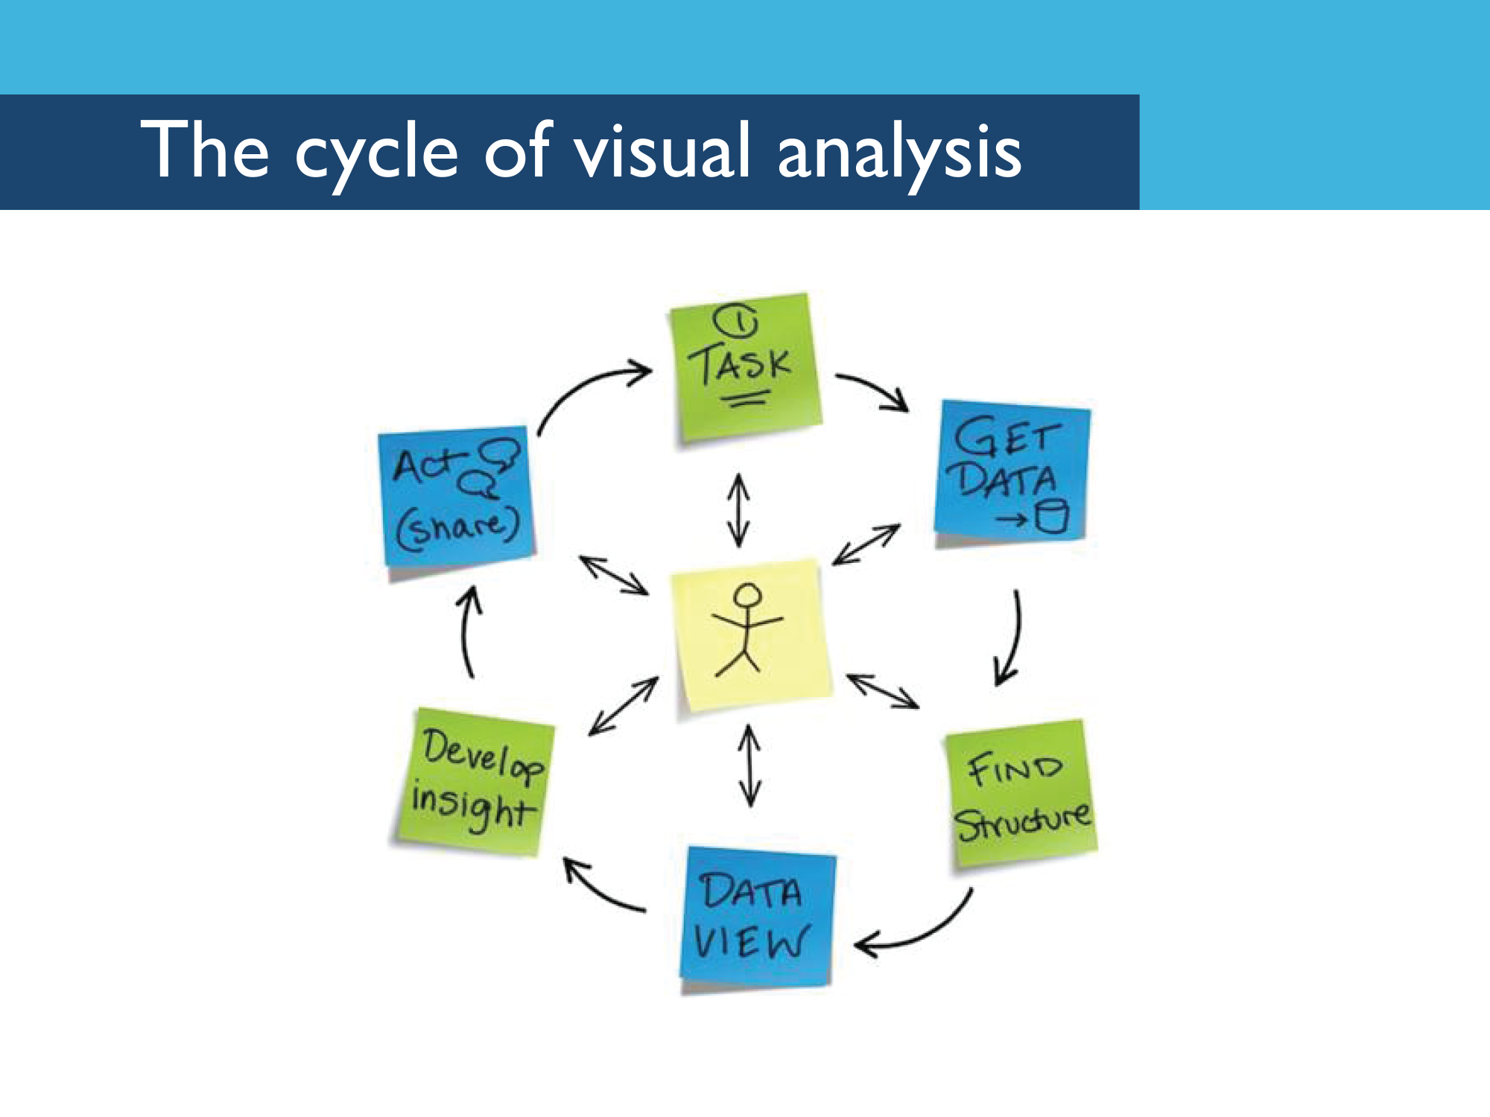
Notes:
Visual analysis isn’t just looking at a chart, or using colors – it’s an entire lifecycle that includes identifying and getting your data, establishing the structure of that data, choosing the best way to visualize that data, drawing conclusions or insight from those visualizations, and then getting buy-in around any conclusions supported by that data, which means you have to be able to tell a compelling story succinctly. And to help a team benefit from visual analysis, you need to support the whole cycle of visual analysis.
[Sometimes it’s good to read these off one step at a time. Mostly because people like to have time to get out their iPhone and take a picture of the slide.]

Slide 20
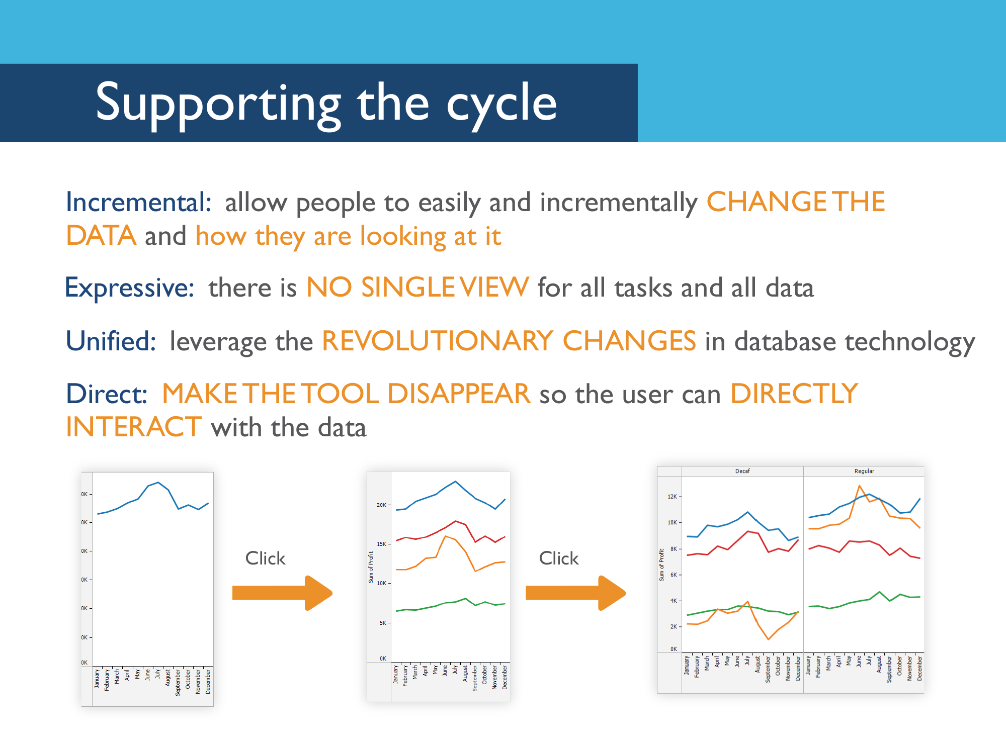

Slide 21
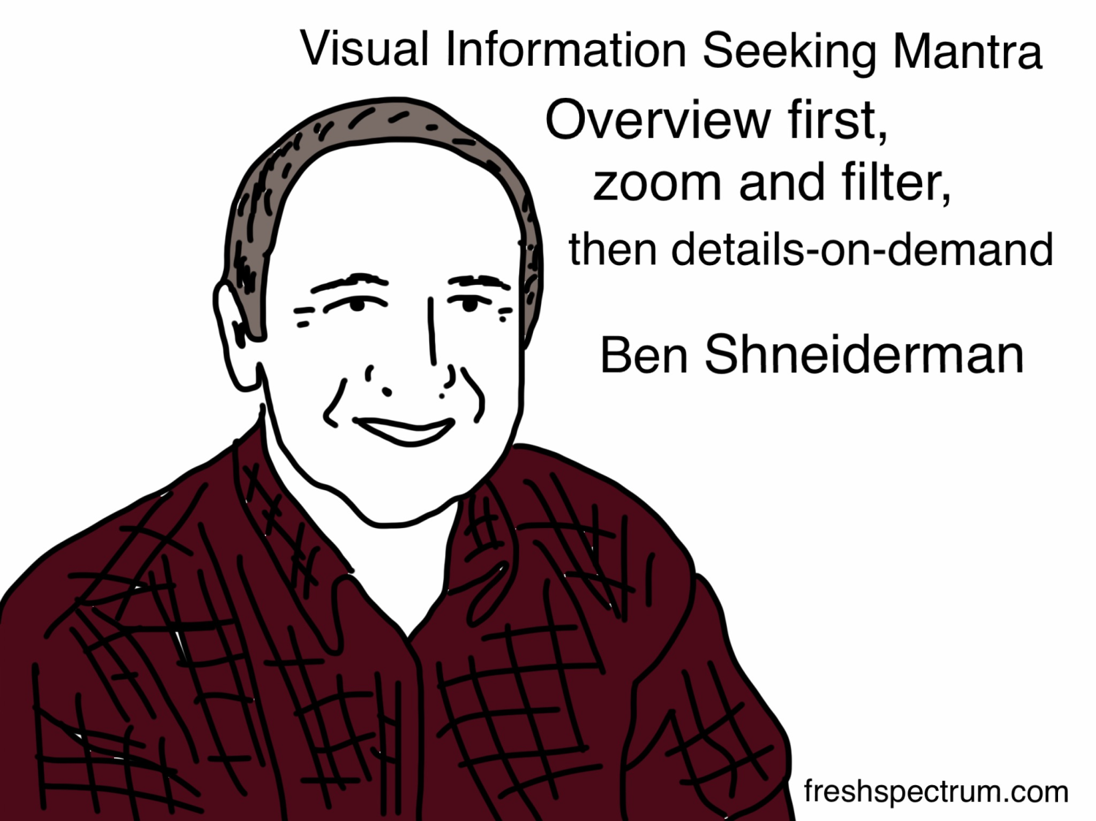

Slide 22
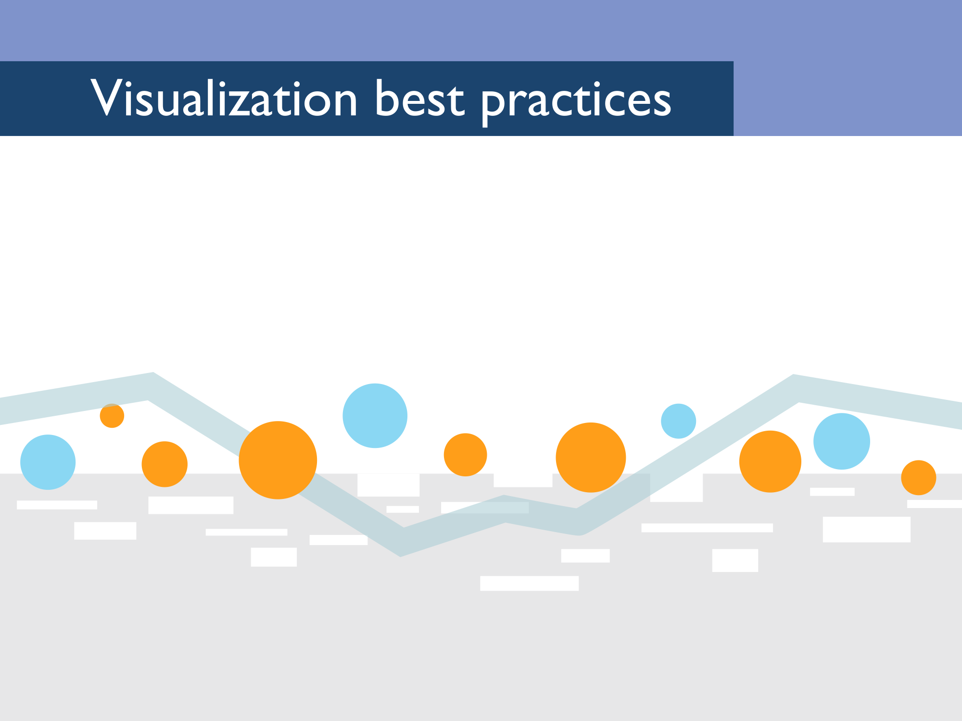

Slide 23
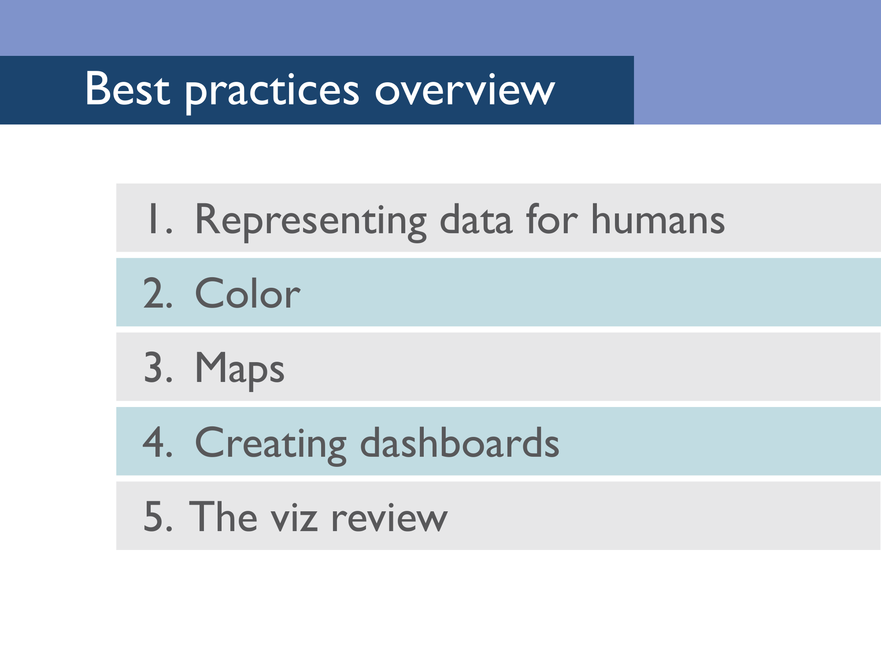

Slide 24
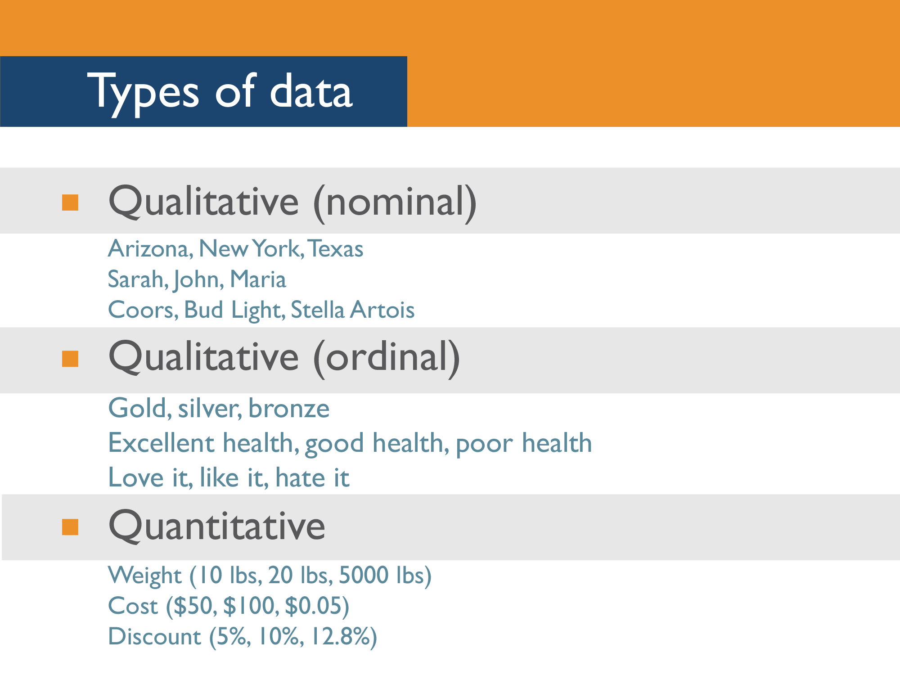
Notes:
Just run through the different types of data. People usually get this quickly but sometimes they like to take photos of the slide.

Slide 25
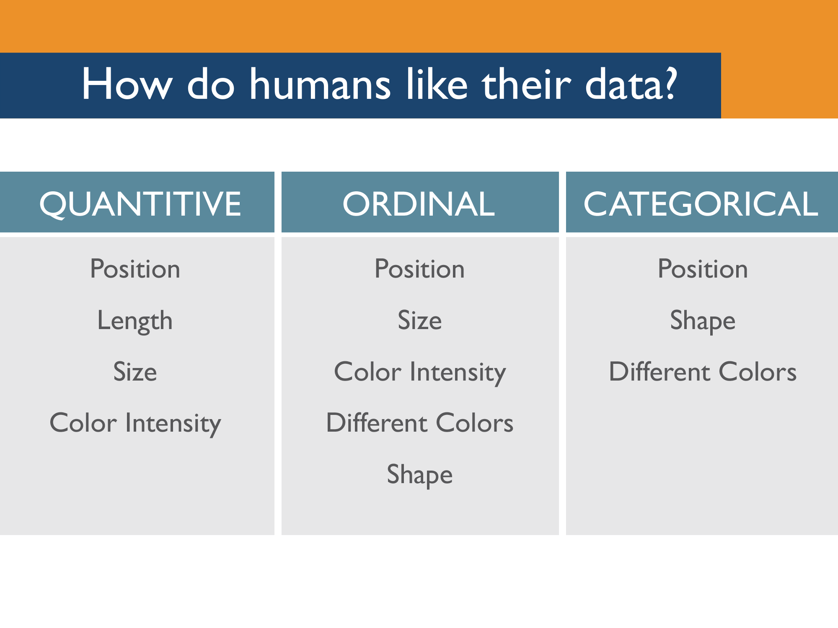
Notes:
Across all data types, people work best when information is presented as a position.
After that, the preference varies based on the data type.

Slide 26
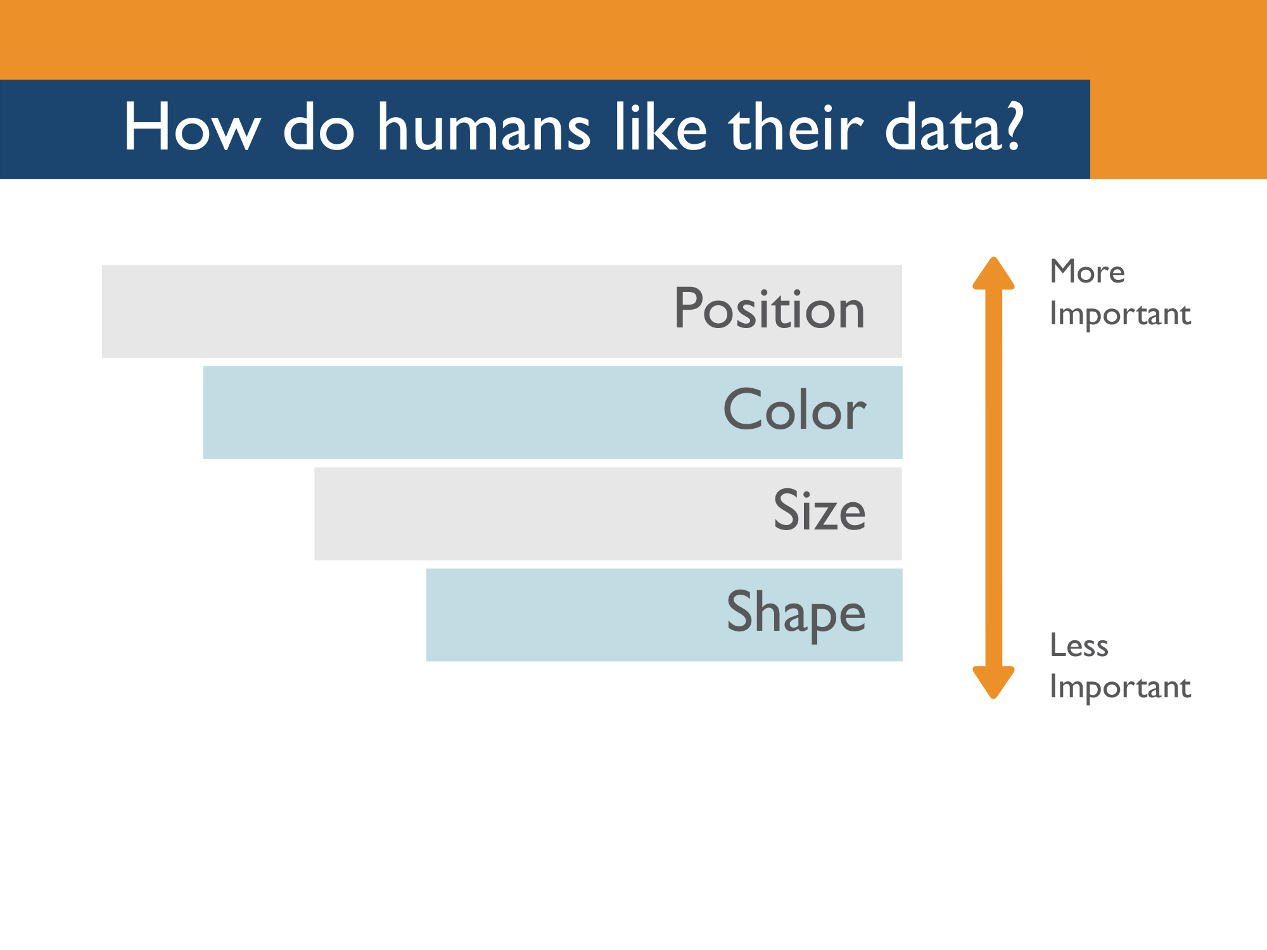
Notes:
The human brain sees position as the most important factor when it’s looking at data.
After that comes color, size and shape.

Slide 27
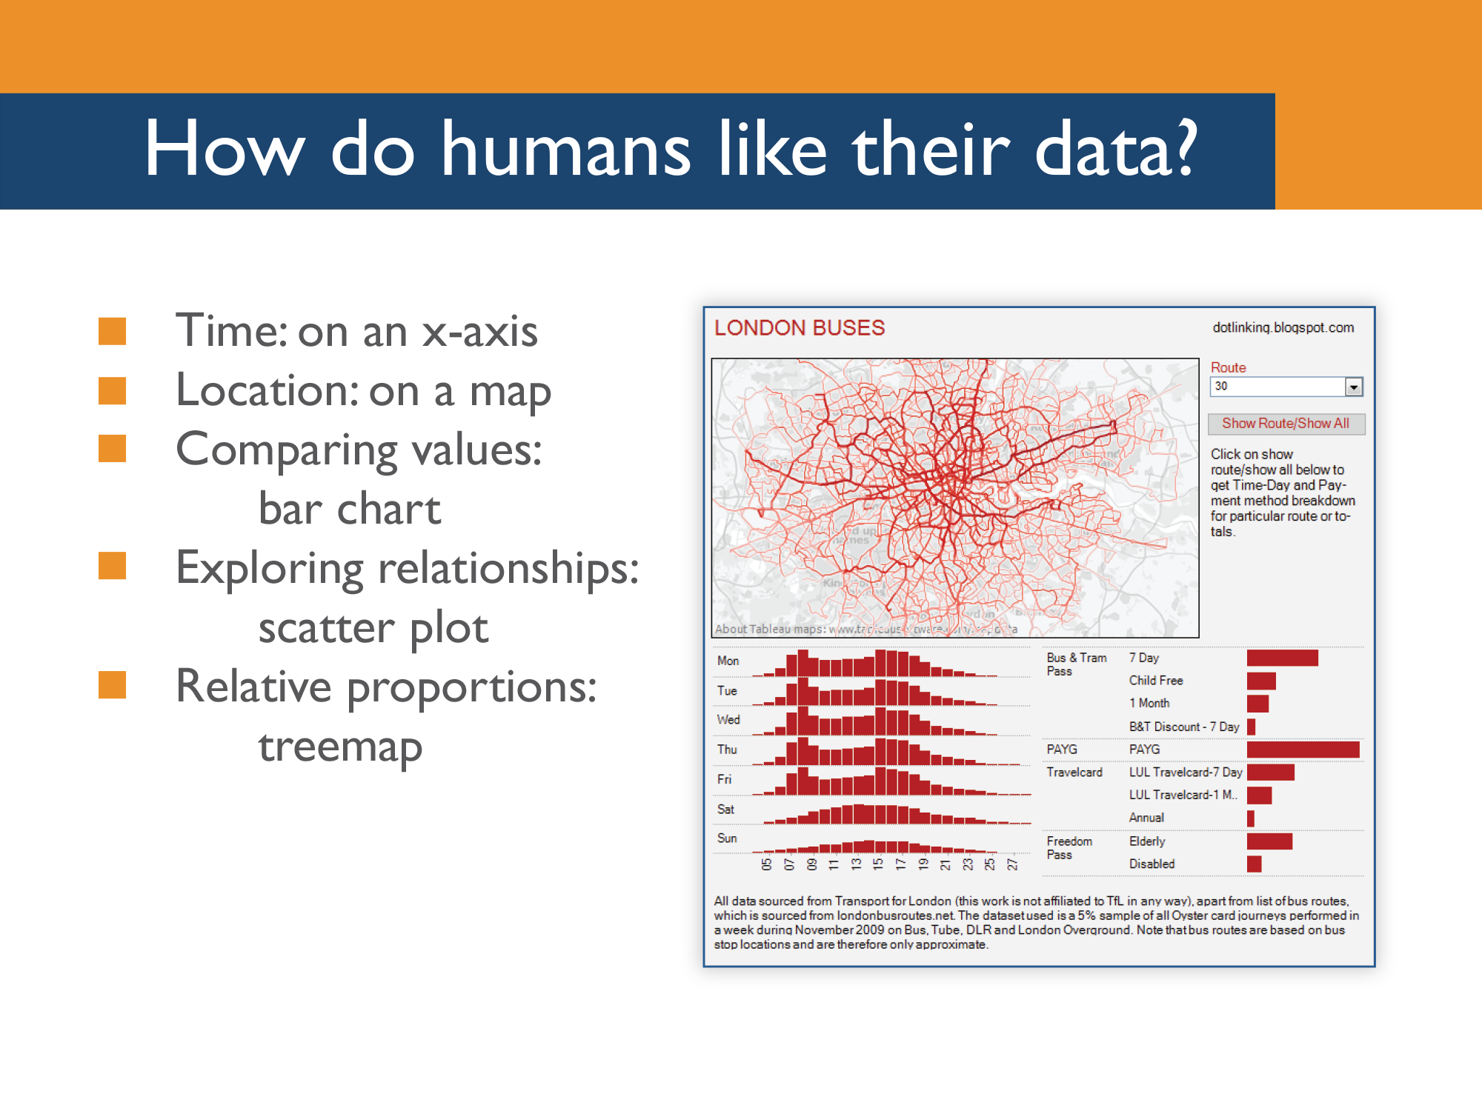

Slide 28
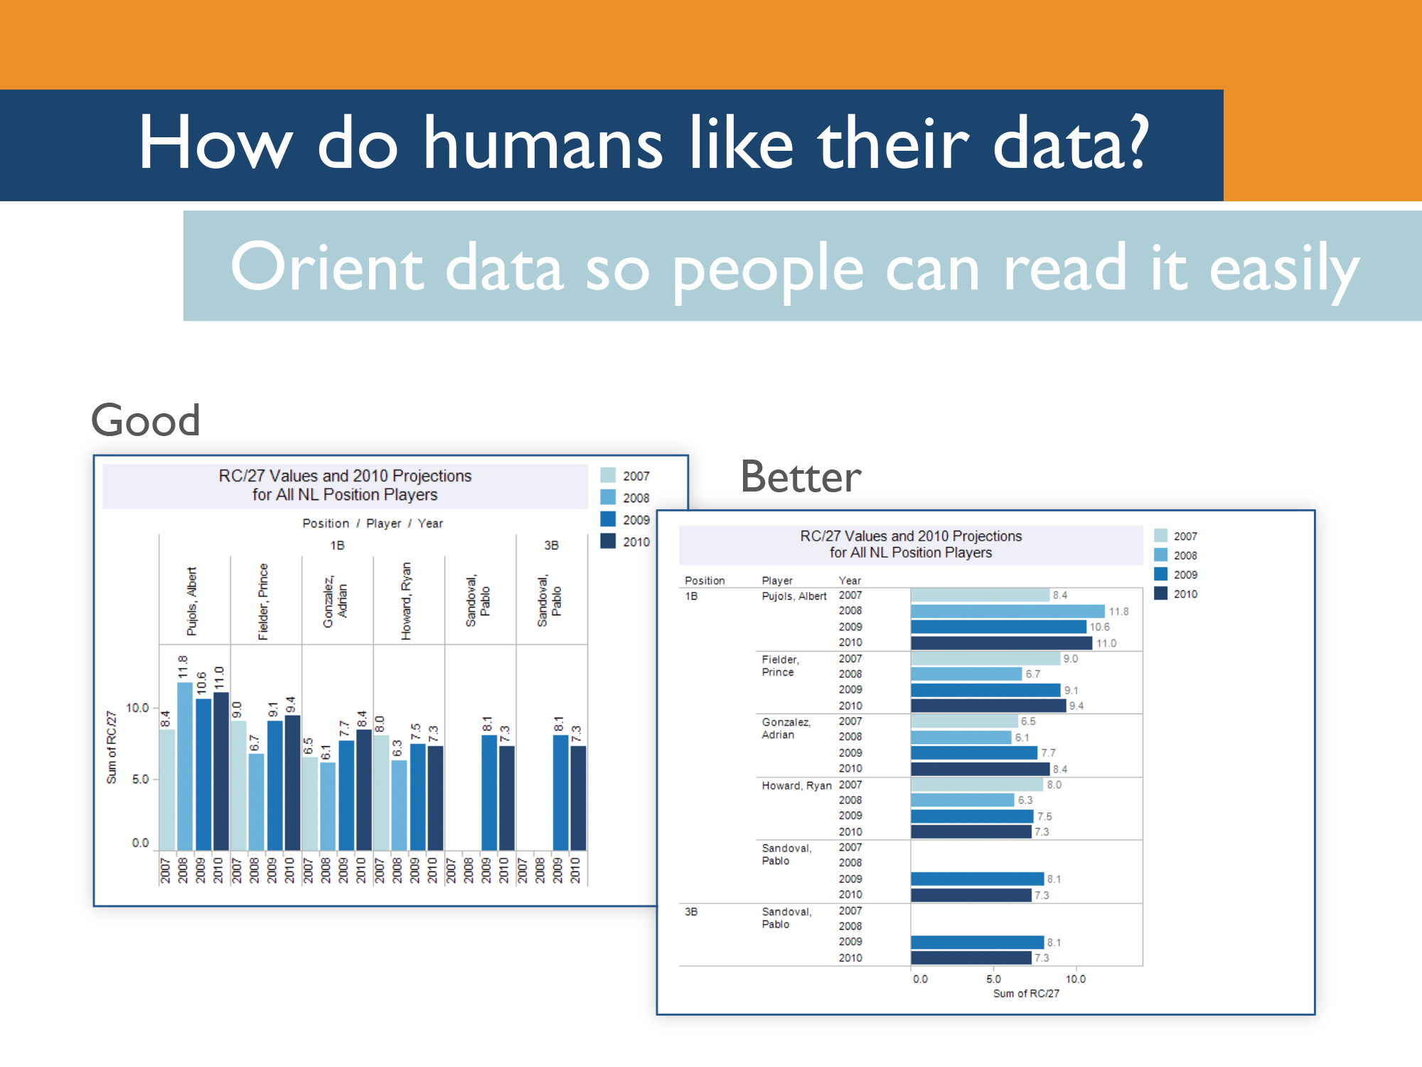
Notes:
It’s a simple tip, but as often as possible, orient the text in a dashboard so that it’s natural for humans to read it
The first visualization here is just fine, but it becomes much easier to read when the text is oriented left-to-right. You can accomplish this with just a single click in Tableau.

Slide 29
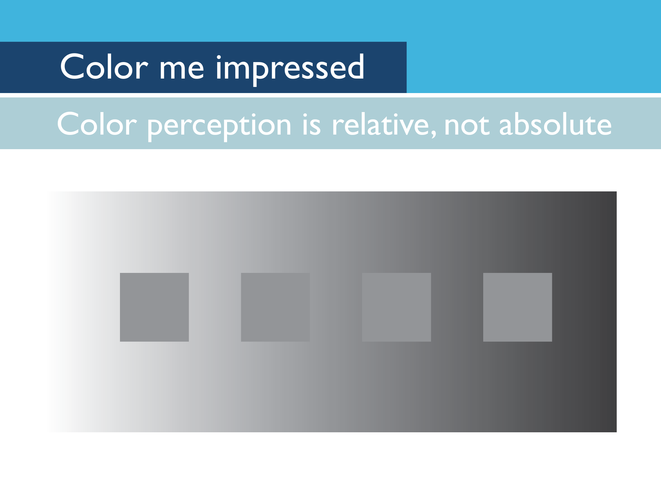
Notes:
[Ask the audience which of the squares is darker. At this point, they usually get the right answer.]

Slide 30
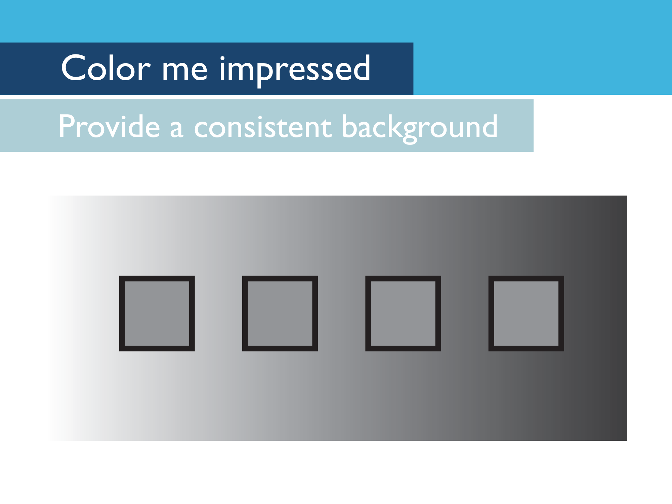
Notes:
All the squares are actually the same color, but it’s hard to tell that when they don’t have a consistent background. When you’re sharing information using color, and especially color density, it’s important to provide a consistent background for your audience. One way to do this is by using borders, but in general you just want to provide a consistent color in your background.

Slide 31
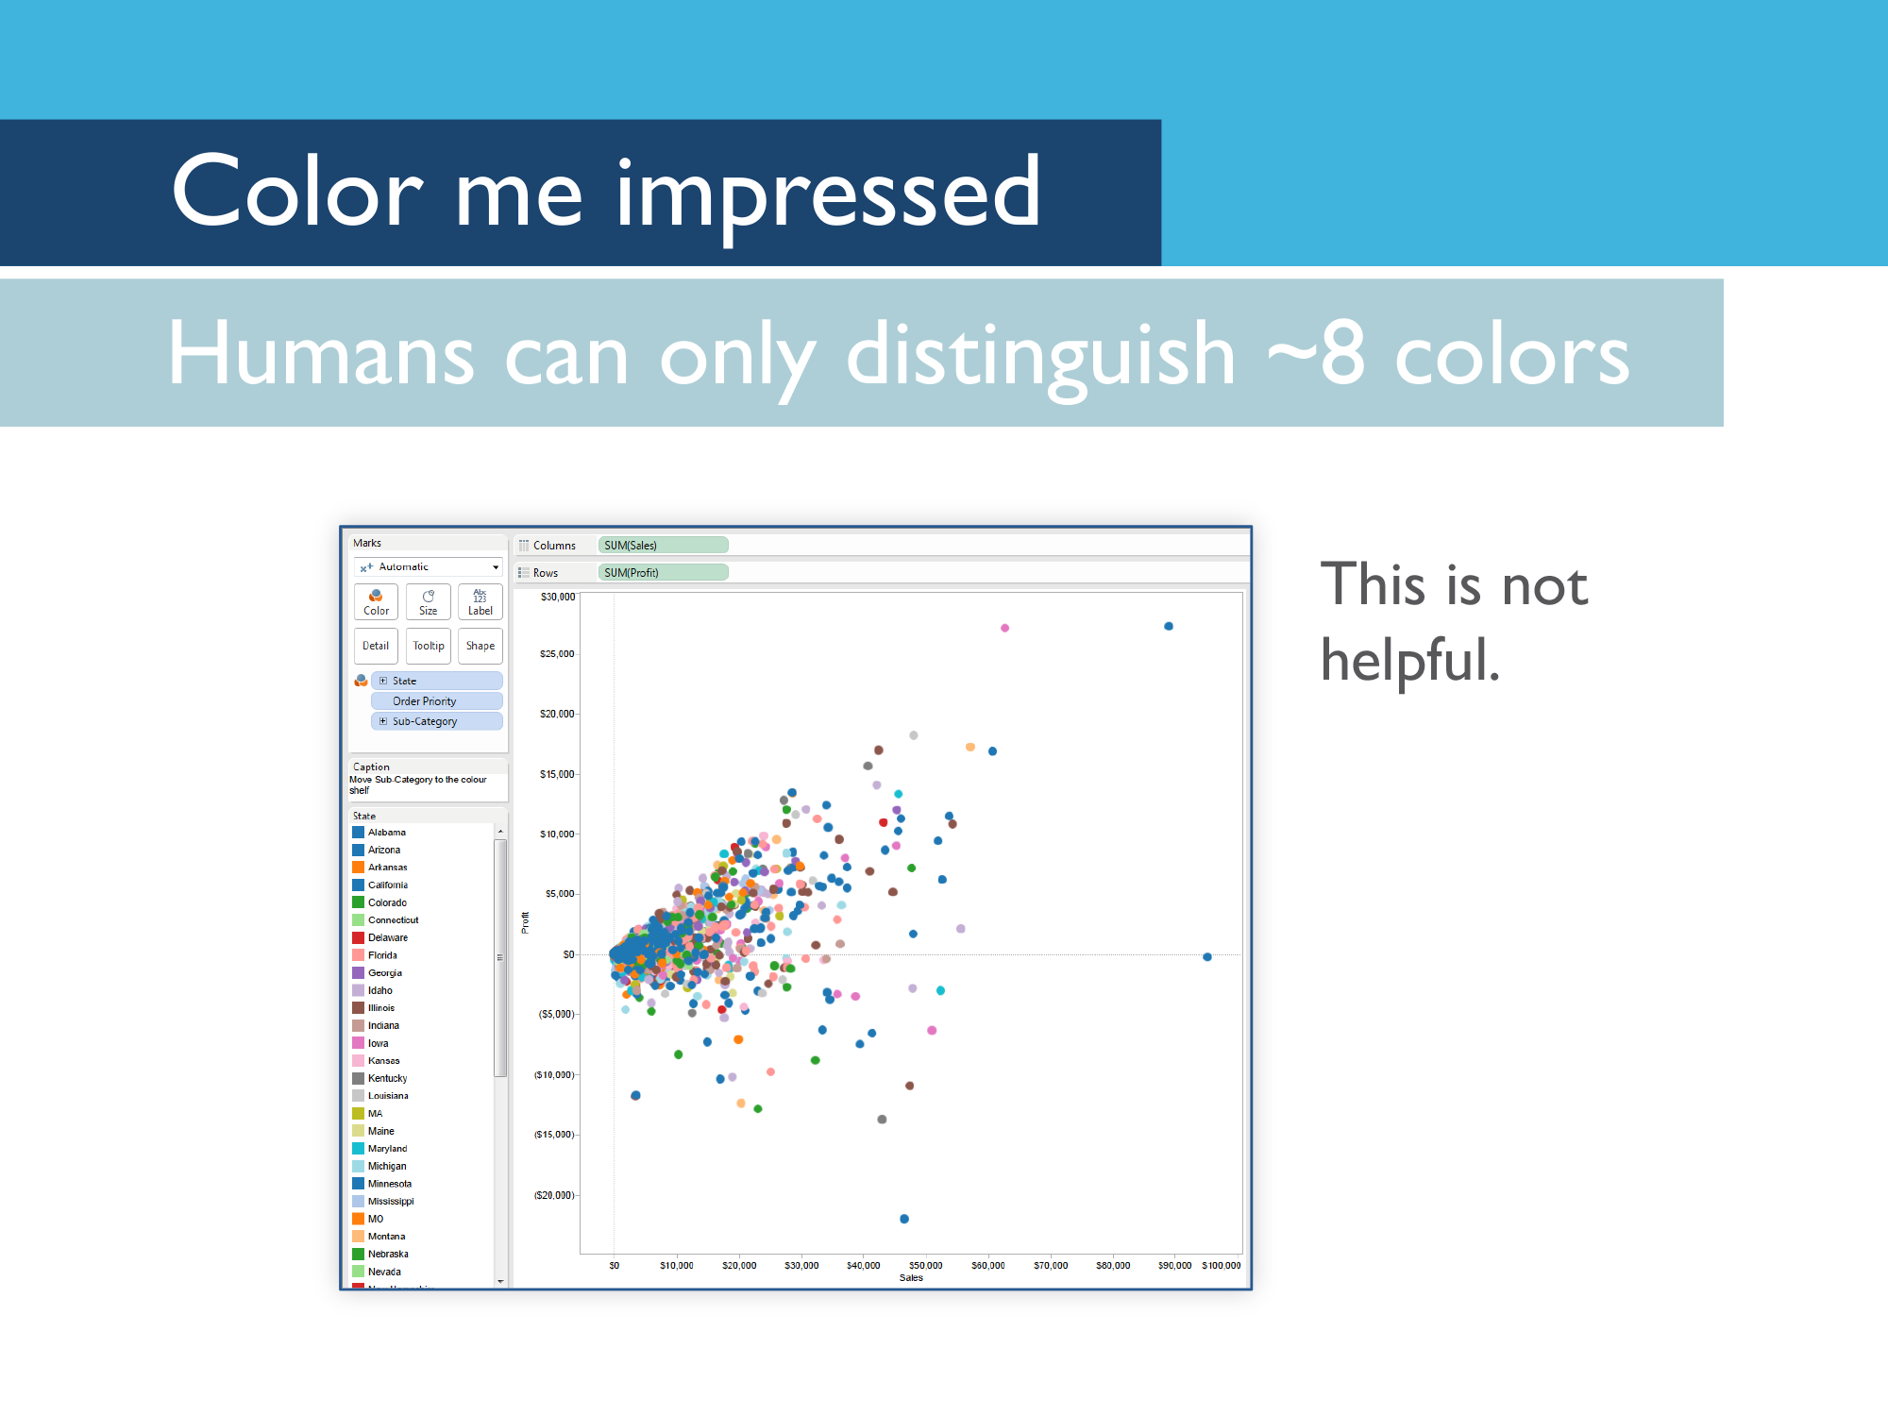

Slide 32
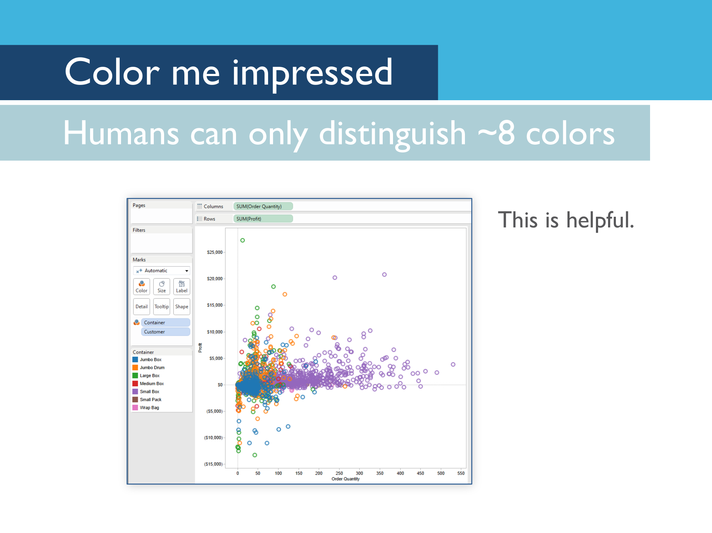

Slide 33
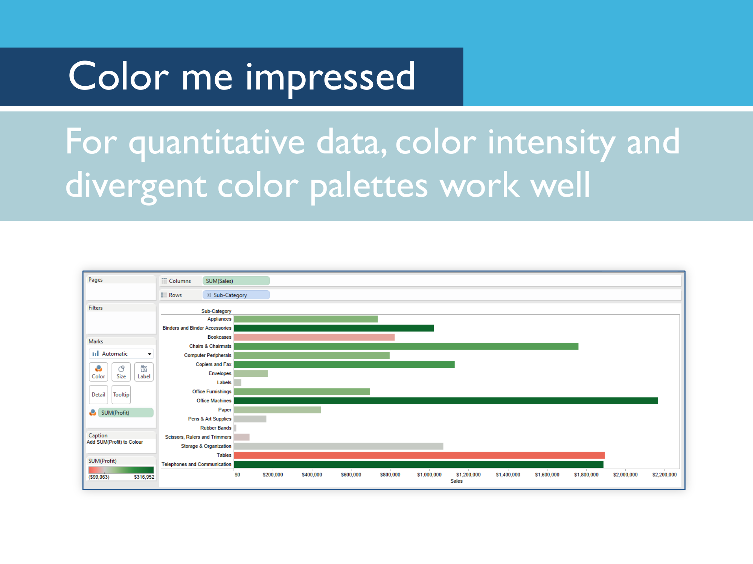

Slide 34
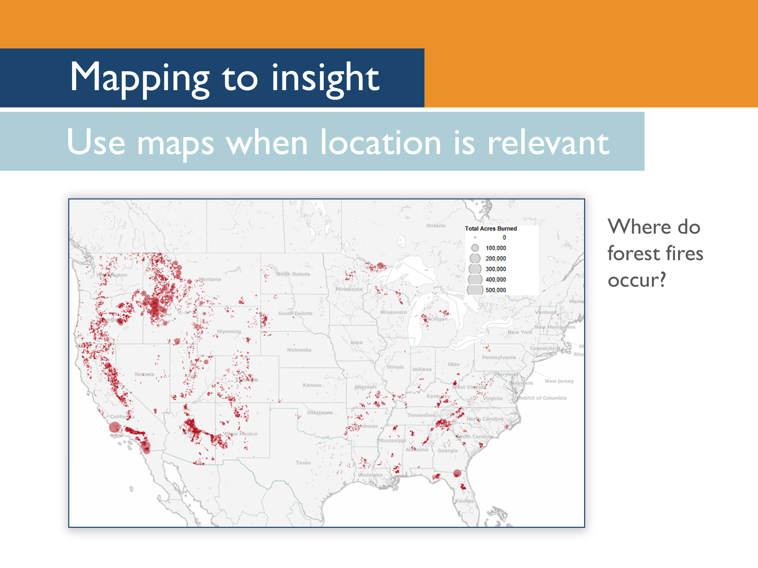
Notes:
Maps are very cool, but they’re not always the best way to present data. Use maps when location is relevant. In this case, we’re looking at where forest fires have occurred. It makes a lot of sense to present this data on a map.

Slide 35
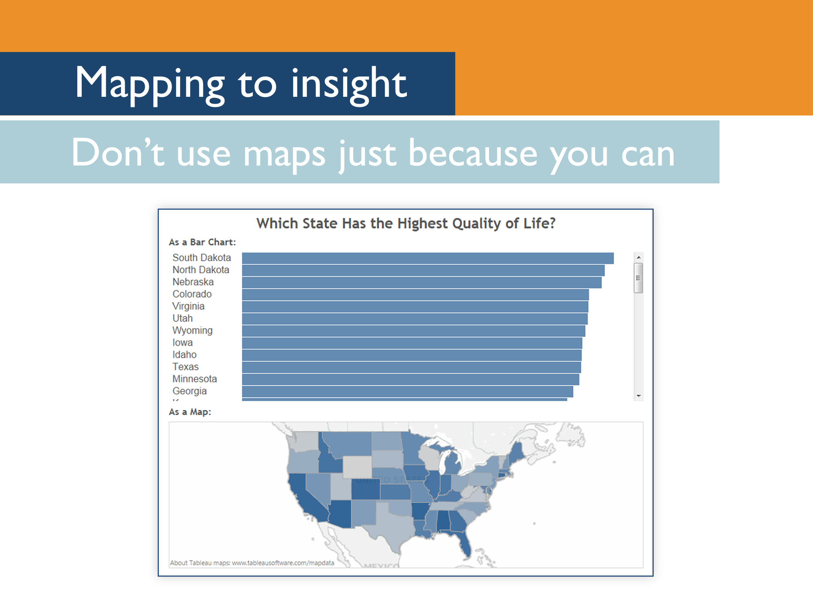
Notes:
But in this case, we want to give our audience information about which state has the highest quality of life. We want to allow them to compare values here, so a bar chart makes more sense. The map with color density can be supplementary, but it would be difficult for them to spot the smaller differences between states if we only presented the data using a map.

Slide 36
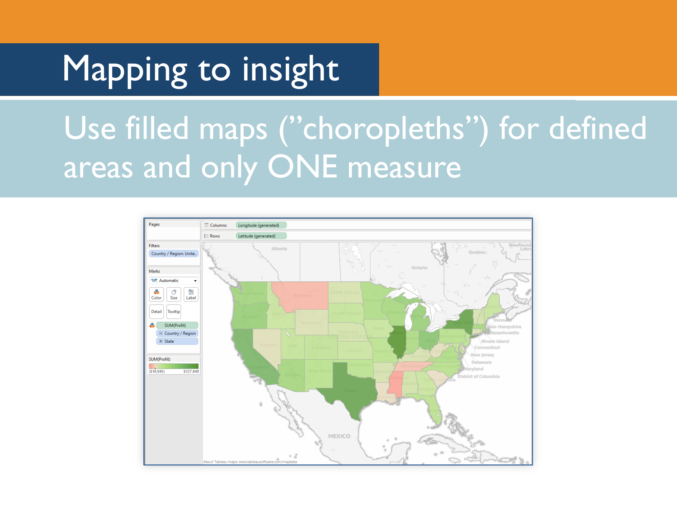

Slide 37
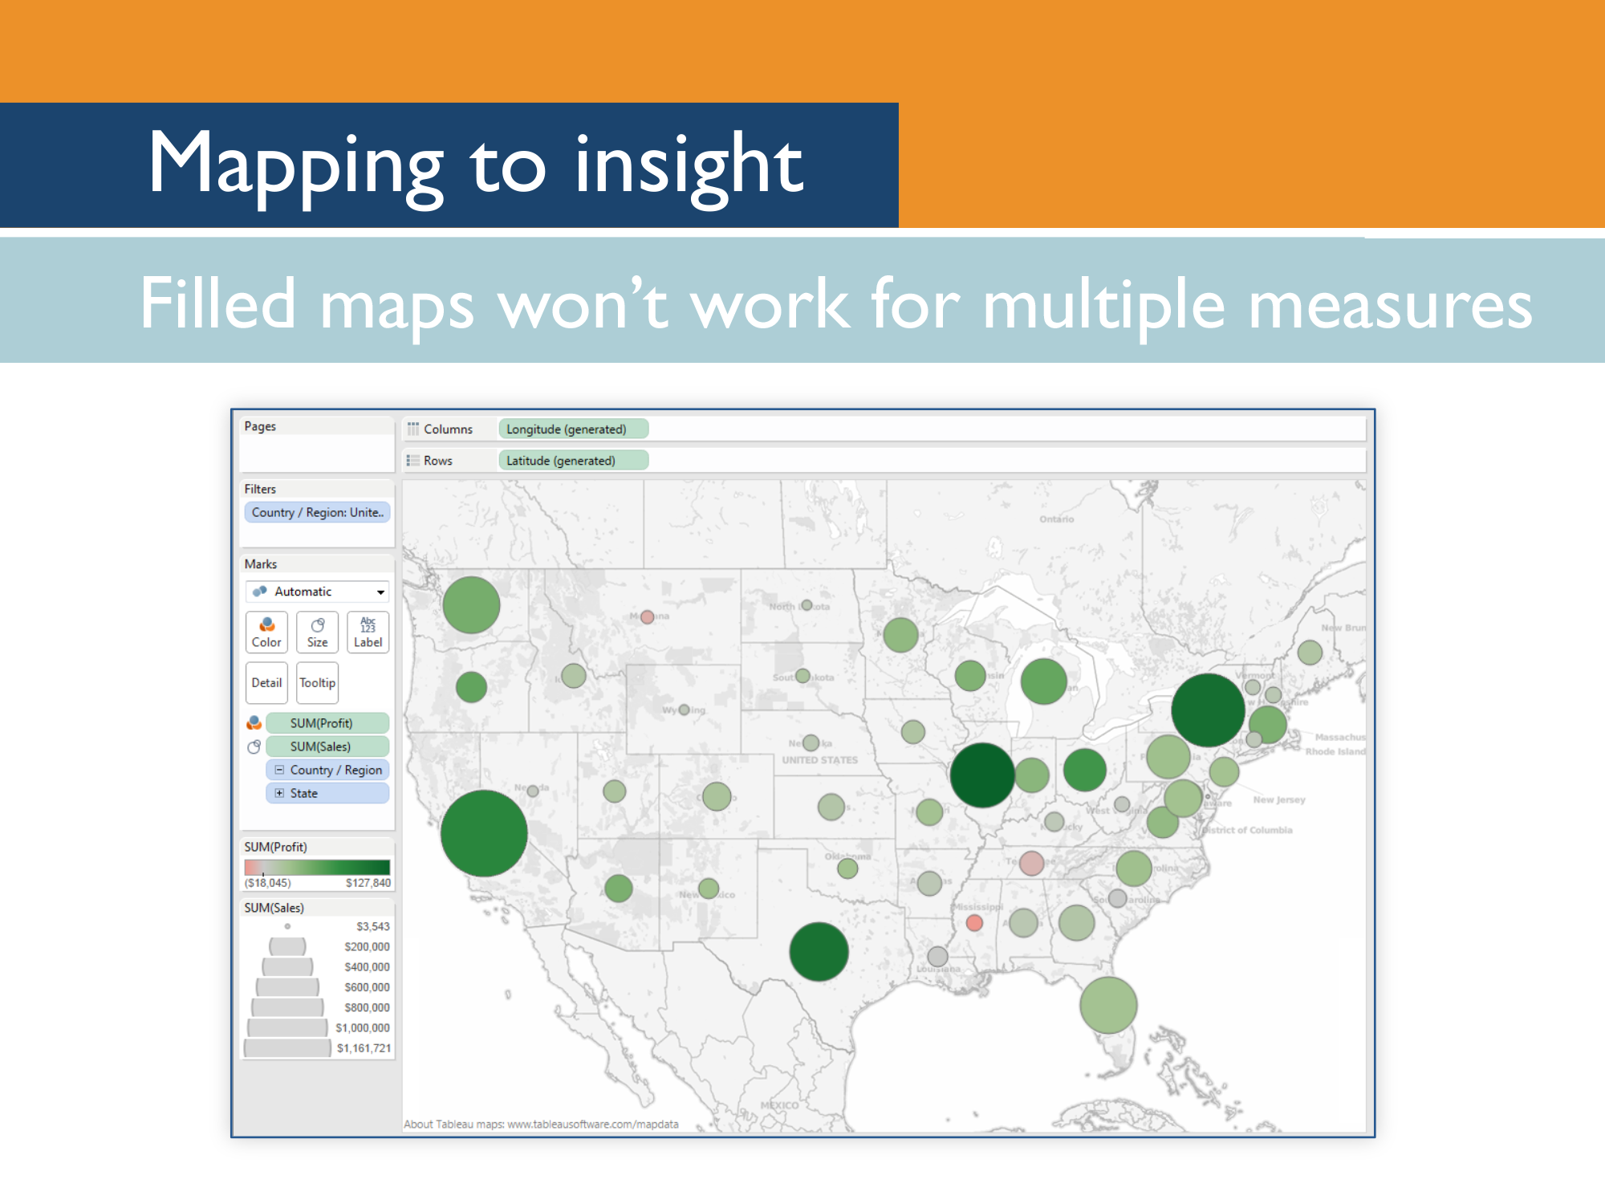

Slide 38
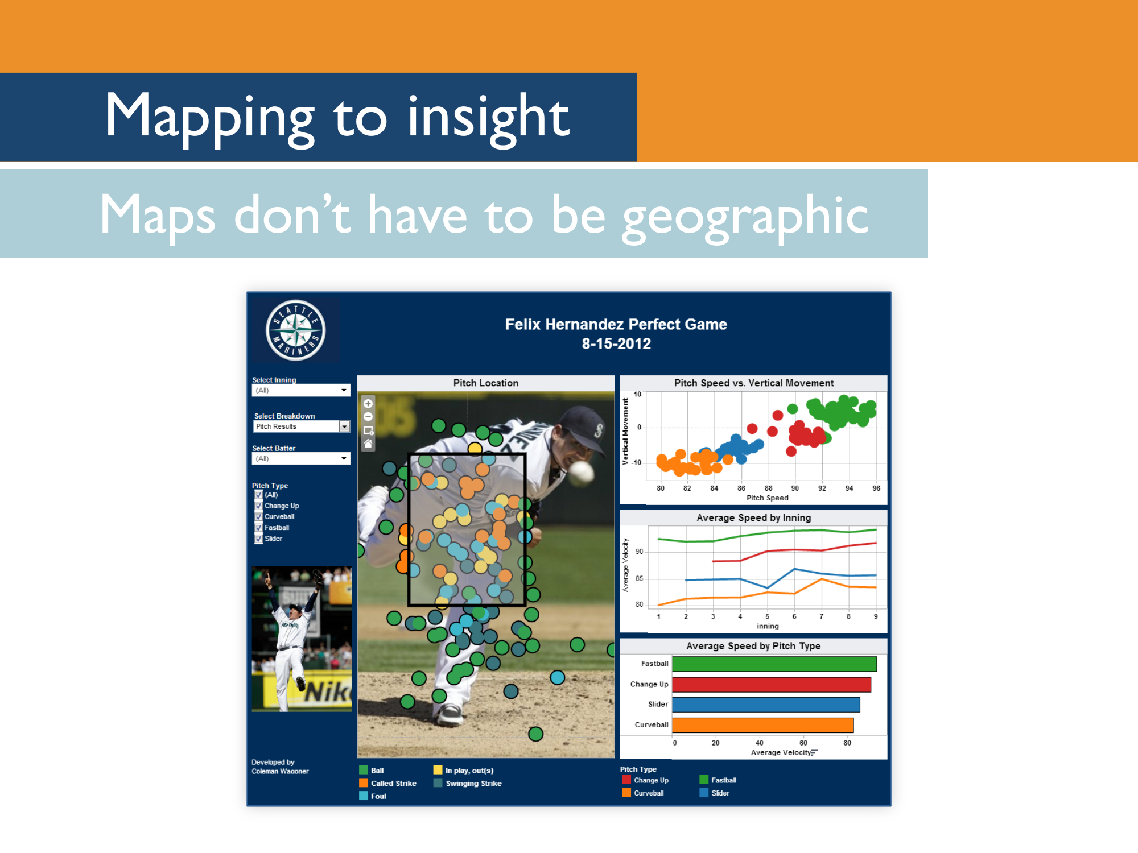

Slide 39
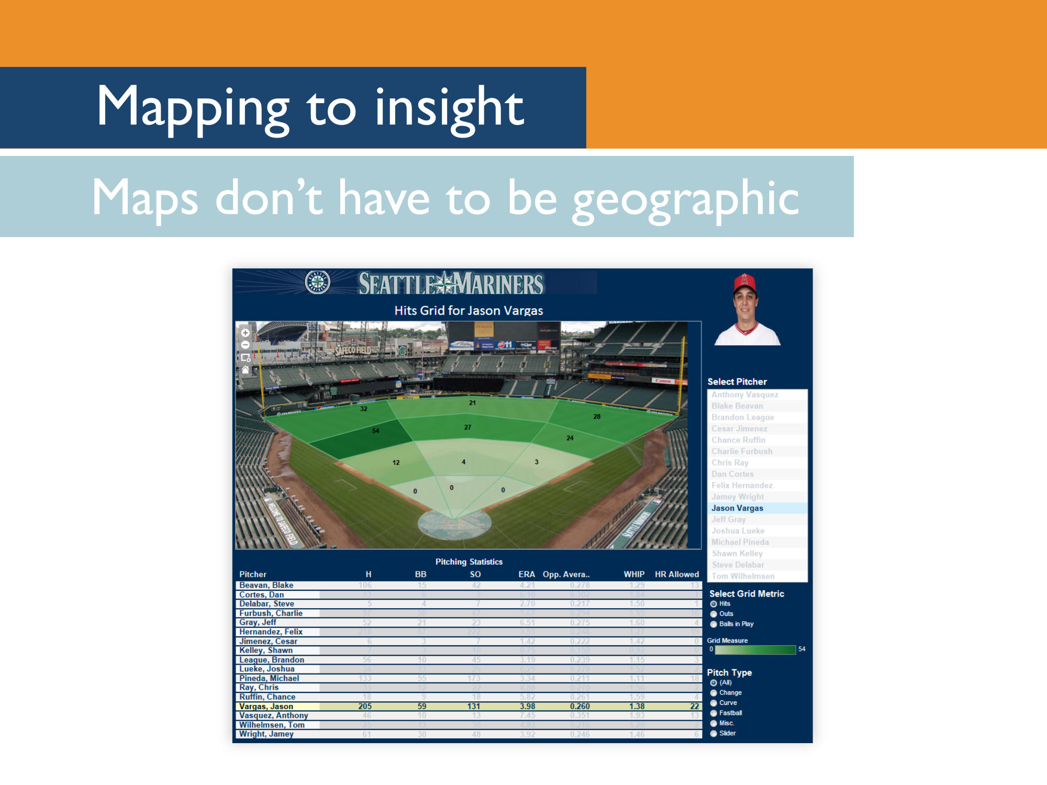

Slide 40
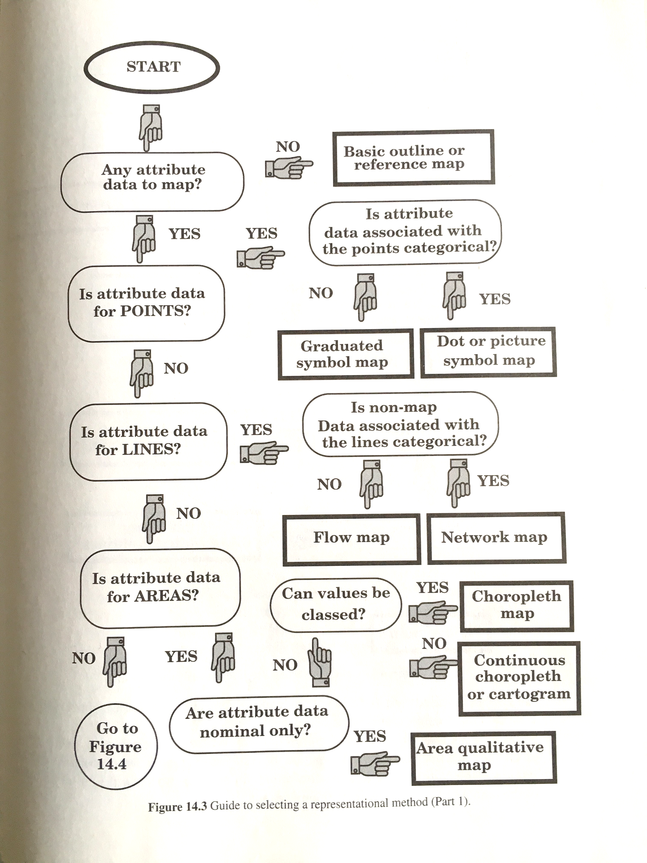
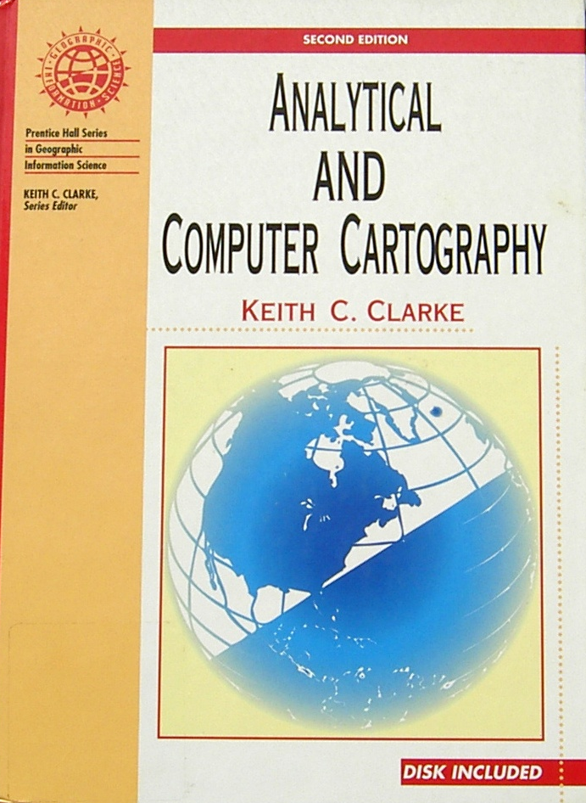

Slide 41
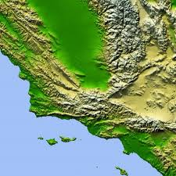
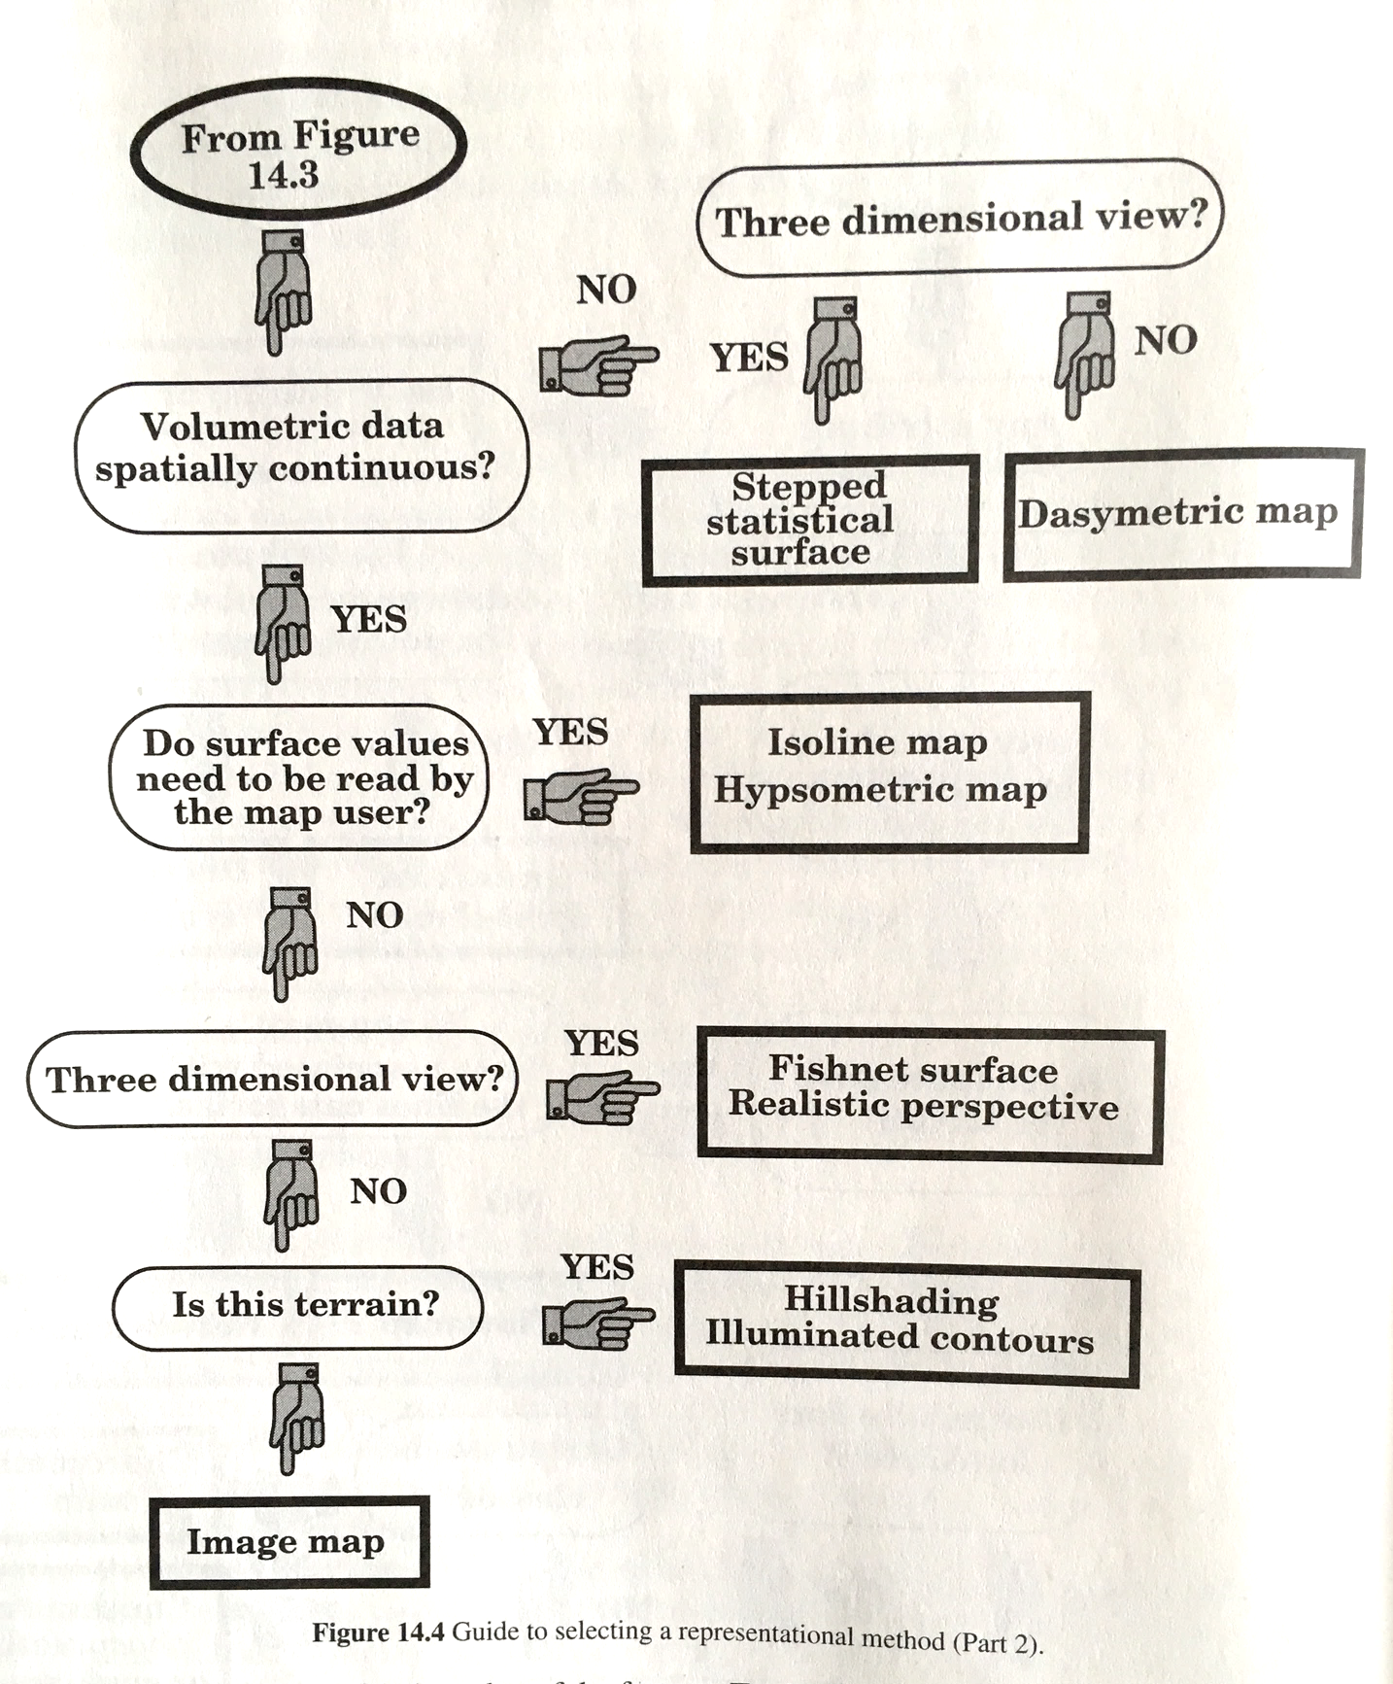
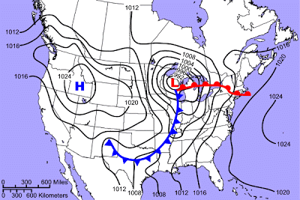
hypsometric map
isoline map

Slide 42
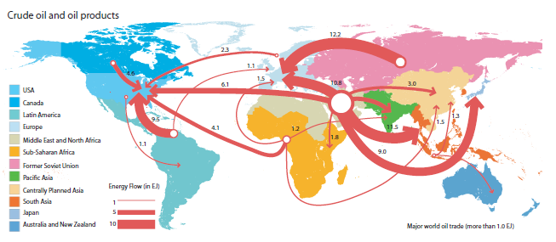
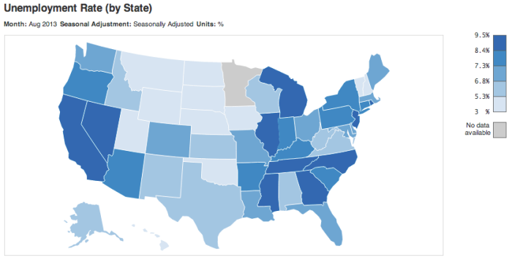
flow map
choropleth map

Slide 43
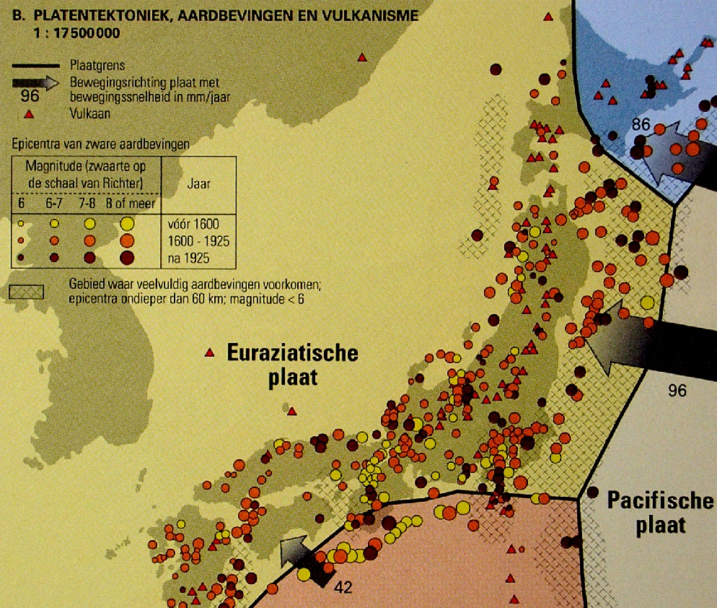

Slide 44
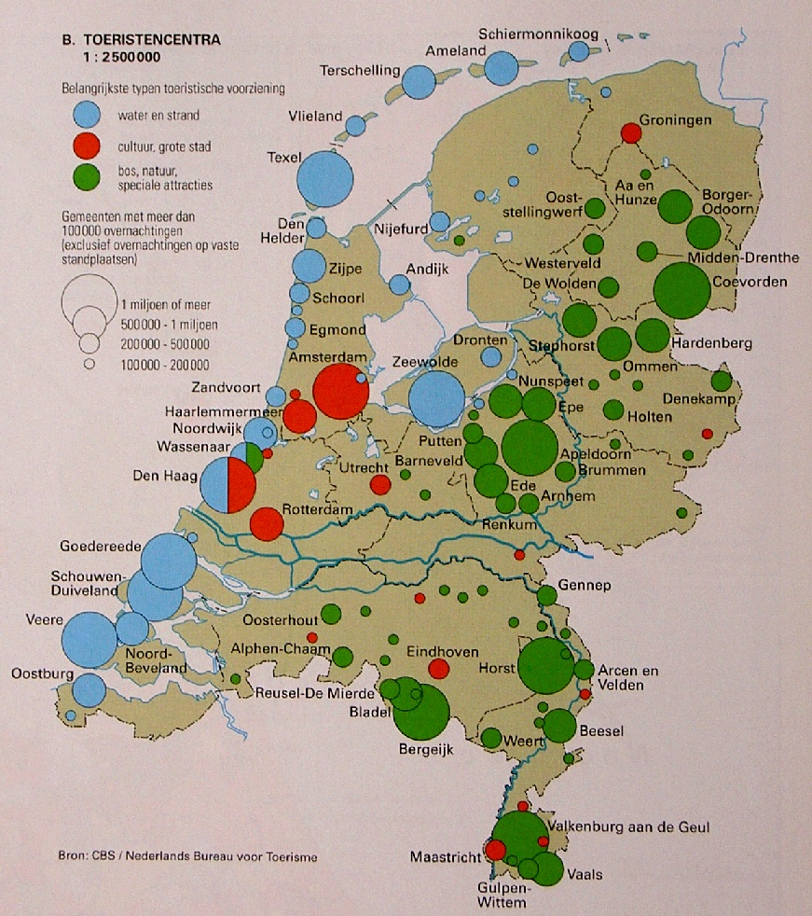

Slide 45
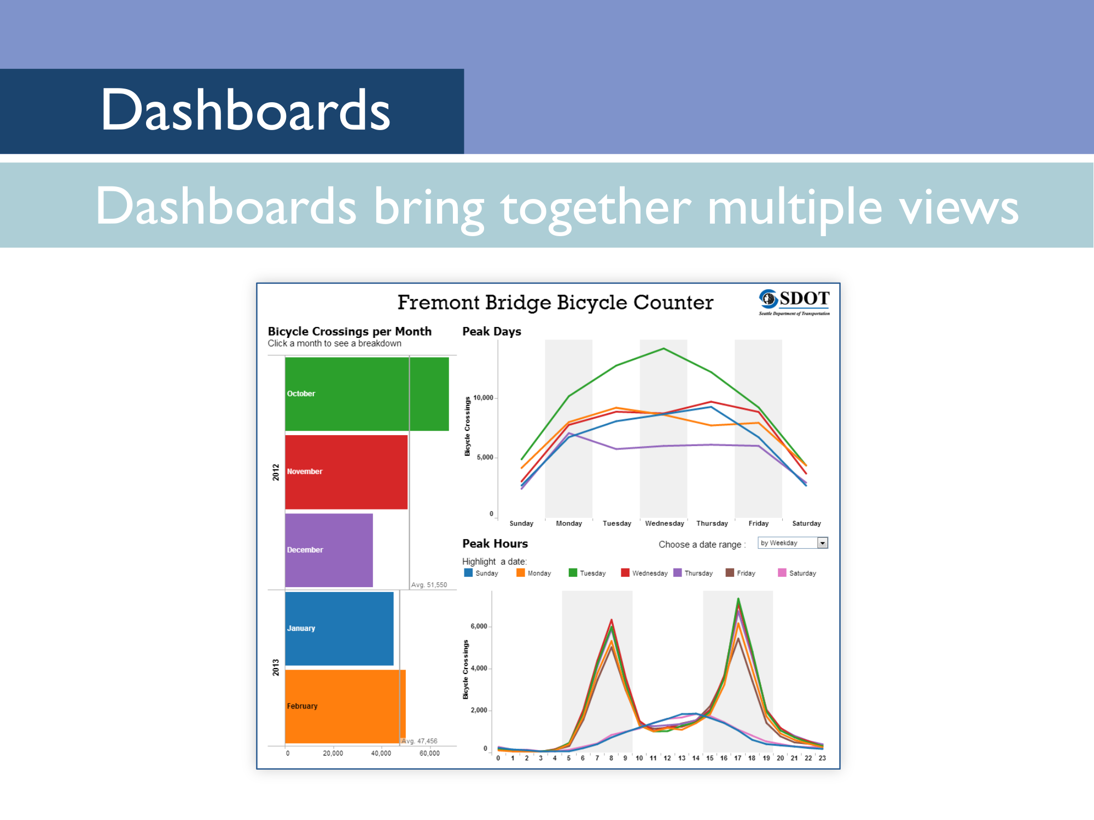

Slide 46
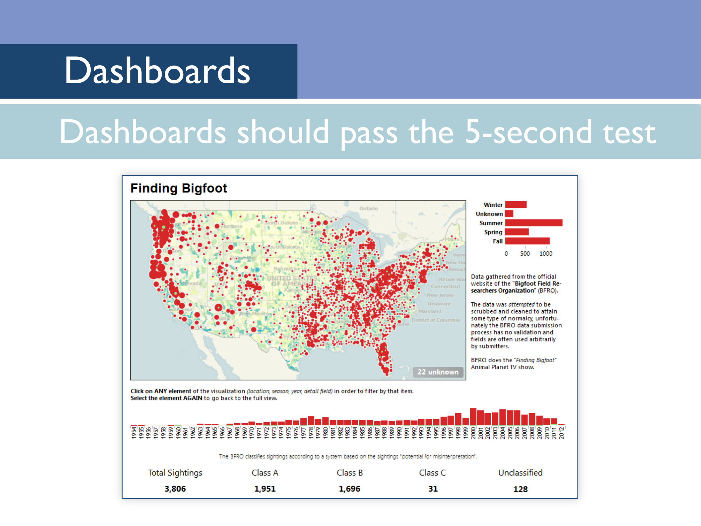
Notes:
[The 5-second test is that it should take about 5 seconds to figure out what the heck’s going on in a dashboard]

Slide 47
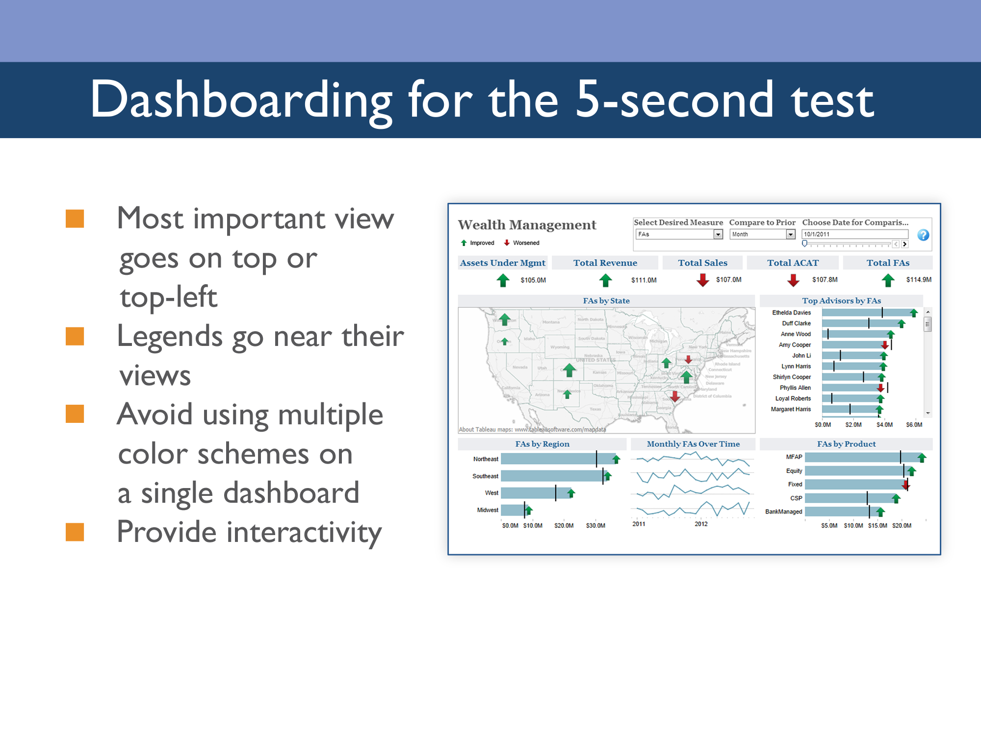

Slide 48


Slide 49

Notes:
After creating something you are ready to publish, invite 3 or more colleagues to a 30 minute meeting and show them your visualization. Now you’ll hand over the mouse and let them click through everything, come up with potential issues and uncover broken parts. A viz review is the same concept behind software engineers holding a code review or an author using an editor before publishing his novel.
EVERYONE who publishes an externally-facing visualization should conduct a viz review. This is a common practice at Tableau, from our top executives down. Anyone publishing an externally-consumed viz goes through this process.
This is important for a few reasons – it maintains accountability and ensures that the finished viz product has been reviewed. The collaborative aspect of a viz review is also a valuable piece - each person in the viz review leaves smarter with new knowledge just by hearing what others have contributed.
ords are are see, understand, and people. Tableau builds software for people, not specialists. We believe anyone should be able to harness the power of data. That’s our mission.

Slide 50


Slide 51

Notes:
Here’s an example of a viz before a viz review. What are some issues you spot here?

Slide 52

Notes:
So here’s what this viz looked like after the viz review. Some key changes:
Titles are clearer, and there’s some supporting text about where the data comes from.
We’re able to tell a clearer story in a single view by using pie charts on a map as our primary view, and we still have the regional spend data on size
The color patterns no longer compete
We’ve created a table calc to present even more information on the crosstab below.
The interactivity edge cases all present meaningful results, instead of just a blob of color.

Slide 53

Notes:
Thank you for your time today, at this point we can open it up for any questions you might have.

